Slide 1
Defying Gravity Lesson 1
Background and context
Performing forces and their handling

Slide 2
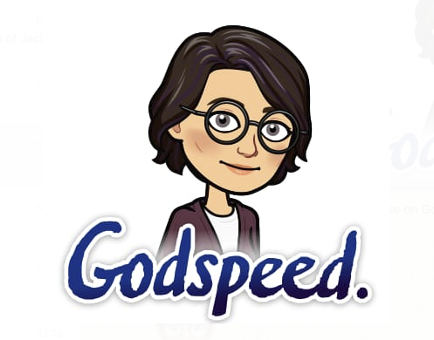

Slide 3
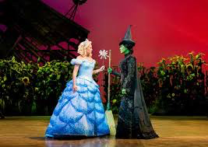
Background and Context

Slide 4
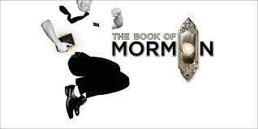
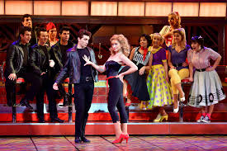
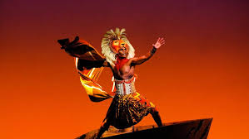
What is musical theatre?!
Musical theatre integrates songs, spoken dialogue, acting and dance within a popular culture.
Opera = classical Musicals = popular music

Slide 5
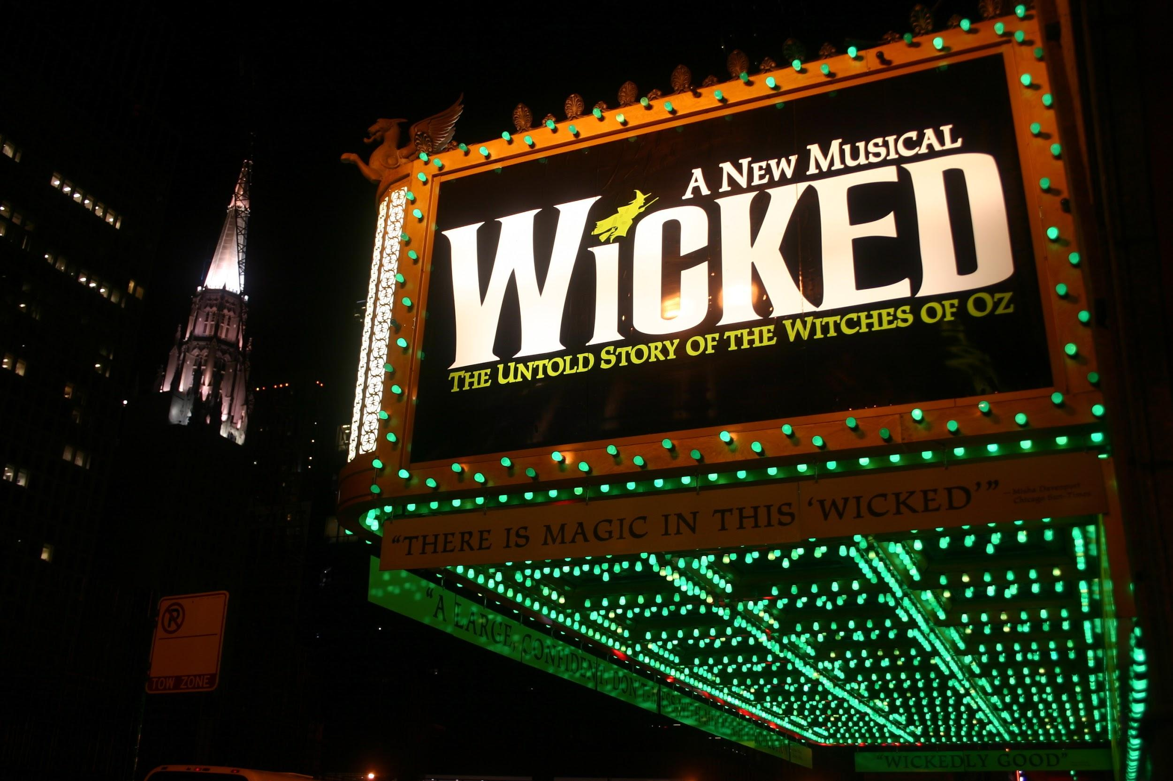
Stephen Schwartz is an American music theatre composer and lyricist.
2003 - the year wicked came out
The Story…
The Untold Story of the Witches of Oz, a musical based on the novel ‘Wicked: The Life and Times of the Wicked Witch of the West’. This is an alternative version of the Wizard of Oz story from the point of view of the witches; Elphaba (the Wicked Witch of the West) and Glinda (Good Witch).

Slide 6
Who composed the Music for ‘Wicked’?
What year did ‘Wicked’ come out?
What was the story about?

Slide 7
‘Defying Gravity’ is the finale song for the first act, when Elphaba discovers that the Wizard of Oz is not the heroic figure she had originally believed him to be. Realising this, Elphaba vows to do everything in her power to fight the Wizard and his sinister plans. She sings of how she wants to live without limits, going against the rules that others have set for her. It was originally written in the key of D♭ major but has been transposed to D major in the Anthology.

Slide 8
What is musical theatre?
What is ‘Defying gravity’ about?

Slide 9
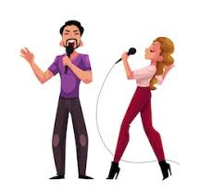
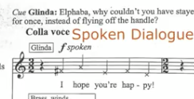
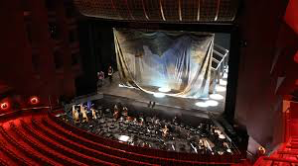
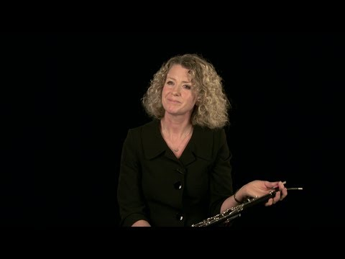
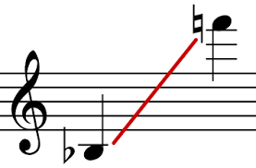
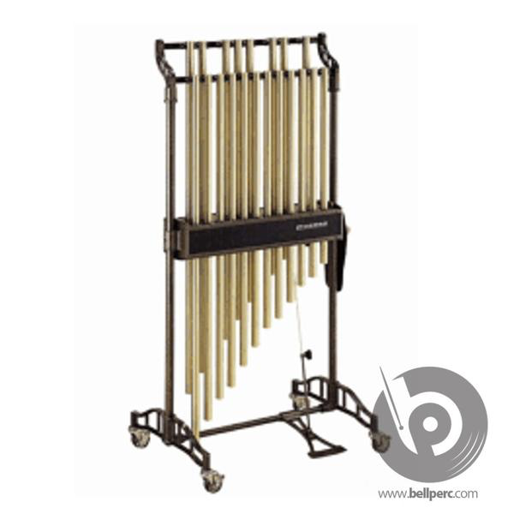
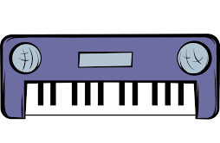
Duet
Spoken dialogue
Large orchestra
Large vocal range

Slide 10
What sort of vocal piece is the song?
What do the crosses mean on the score in parts of the vocal line?
What type of orchestra is used?
What are some of the extra instruments added to the orchestra?

Slide 11
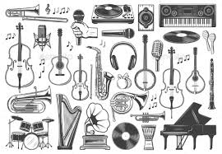
Performing forces and their handling

Slide 12
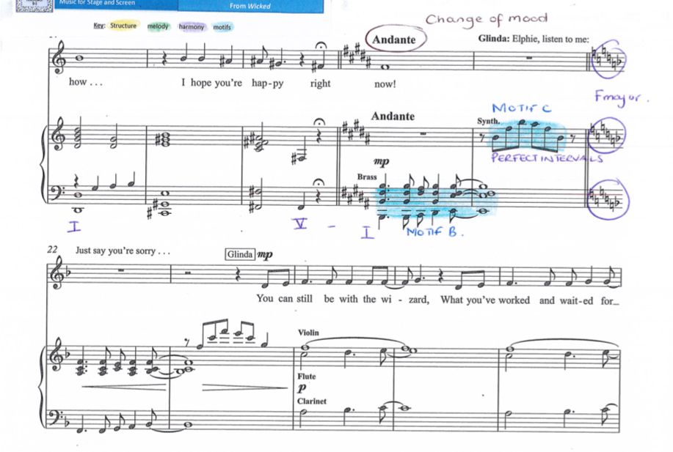
The brass section plays homophonic chordal music in an almost fanfare-like manner (e.g. bar 20).

Slide 13
What is the texture for most of the song?

Slide 14
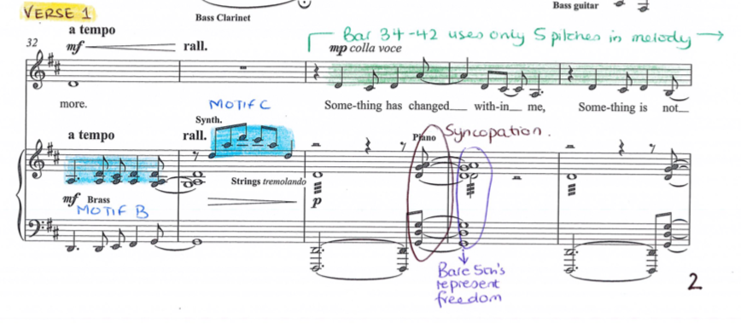
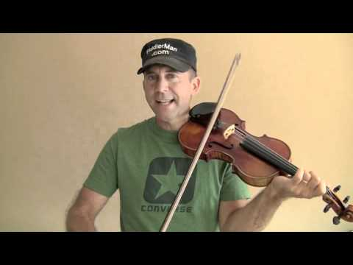
Strings use tremolo effect to add tension (e.g. bar 34).
.34
Tremolo:
repitition of a single note, particularly used on bowed string instruments, by rapidly moving the bow back and forth;

Slide 15
What does the use of tremolo add to the song?

Slide 16
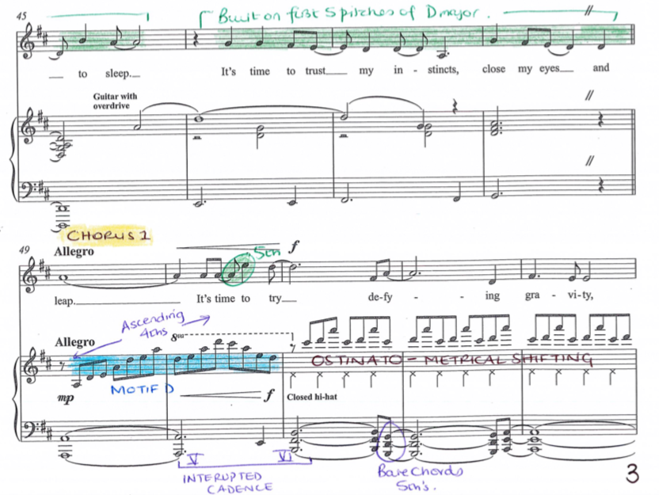
The closed hi-hat of the drum kit plays constant crotchet rhythms in bar 51 to add rhythmic Momentum.
Listen at 1min 42sec

Slide 17
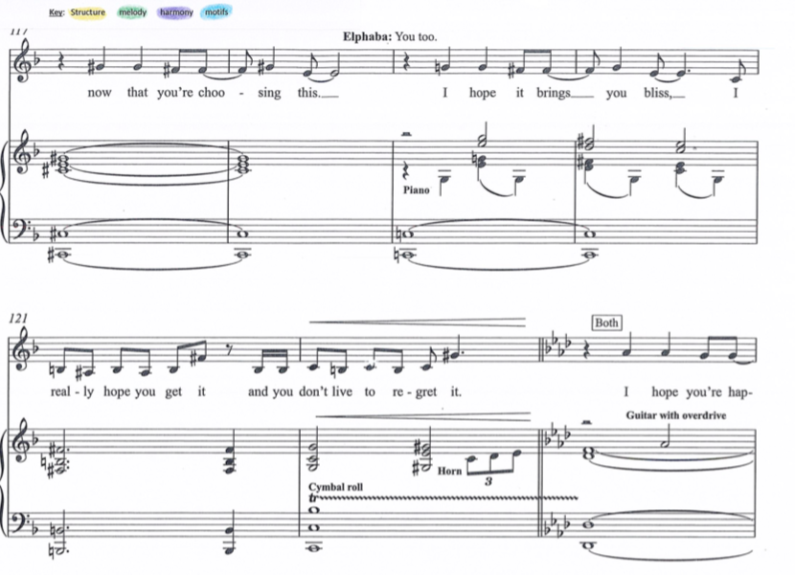
There is a cymbal roll to add excitement as the piece moves into a key change (e.g. bar 122). (3.58)

Slide 18
What is tremolo?
How many beats does a crotchet last for ?
What do the constant crotchets on the hi hat add to the first chorus?

Slide 19
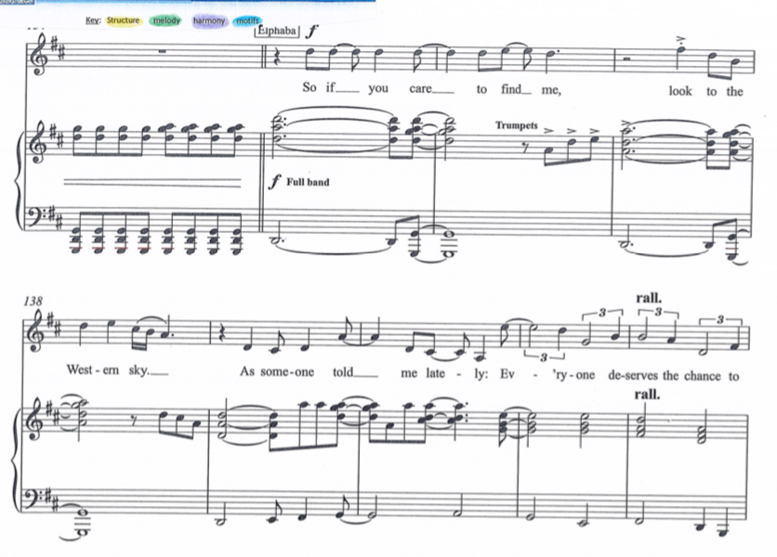
The full band plays at the climax of the song at bar 135.

Slide 20
Summary
Musical Theatre
Stephen Schwartz
2003
Alternative Wizard of Oz
Defying Gravity
Duet
Spoken dialogue
Large orchestra
Cor anglais
Tubular bells
Band
Homophonic texture
Tremolo
Hi-hat constant crotchet
Cymbal roll - crescendo

