Slide 1
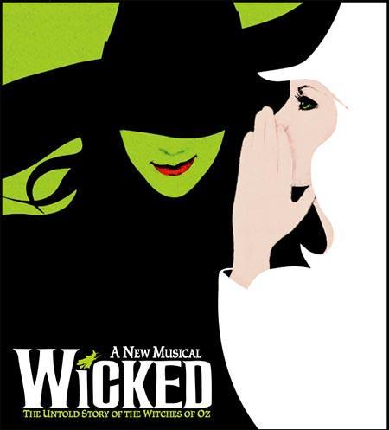
Defying Gravity Lesson 2
Melody, Structure, Texture

Slide 2
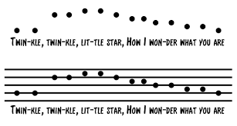
Melody
Melody

Slide 3
The text setting is syllabic throughout with rhythms moving in a speech-like manner.
Syllabic: Where one note is sung per syllable.
Melody

Slide 4
There is vocalisation at the end in bar 175 to the word ‘aah’.
Melody

Slide 5
The melody starts in a conjunct/stepwise manner.
Melody

Slide 6
Bars 6 and 7 show an ascending sequence.
Sequence: Where there is a melody repeated but at a different pitch.
ascending
Melody

Slide 7
The verse and chorus combine conjunct and wide angular leaps in the melodic line. Leaps often feature a rising perfect fifth. There are some exceptionally large leaps such as a compound perfect fourth and a compound perfect fifth (e.g. bars 140–141).
Melody

Slide 8
Structure
verse | chorus | verse | chorus | verse
A | B | A | B | A
Structure

Slide 9
There is a distinct verse–chorus form.
Within that structure this piece has multiple sections which are defined by tempo, contrasting moods and melodic material.
intro | Funny bit | verse | Funny bit | chorus | etc
Structure

Slide 10
Quick note on Italian words for speed of tempo
Andante | moderately slow tempo (so quite slow)
Allegro | Fast
Moderato | Moderate pace (medium)

Slide 11
Monophonic: is a texture where only one melody is playing at a time
Stabs: short sharp notes / chords played by many instruments.
sustained: notes that are held on for a long time.
Chordal: chords!
Accompaniment: The instruments playing behind the melody.
sparse: thinly dispersed or scattered.
Structure

Slide 12
Homophonic: chords with a melody over the top.
Legato: Notes that are played in a smooth way.
Tremolo: repetition of a single note, particularly used on bowed string instruments, by rapidly moving the bow back and forth
Conjunct melody: stepwise melody.
Dissonant: Notes that don’t fit inside a common chord / clashy sounding.
Andante: moderately slow tempo.
Structure

Slide 13
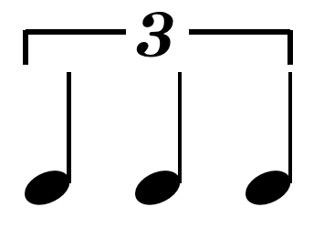
Hook: main melody of the song
triplet: 3 notes.
Syncopated: weaker beats are emphasised.
Structure

Slide 14
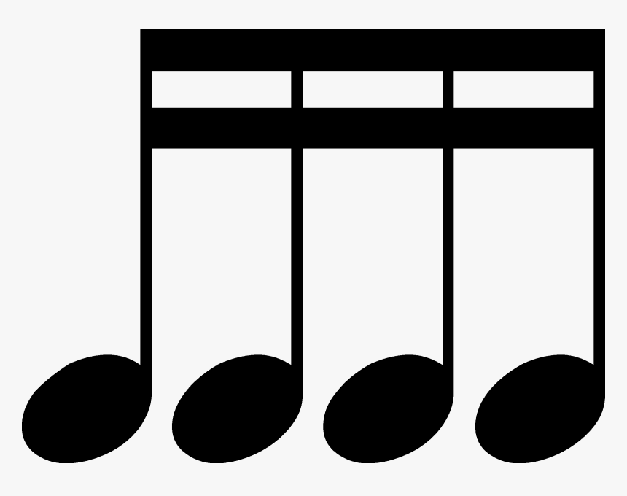
Unison: Where 2 or more people are singing the same melody in this case it's the two soloists.
Semiquaver: ¼ of a beat - think cocacola
Accompaniment: The instruments playing behind the melody.
Structure

Slide 15
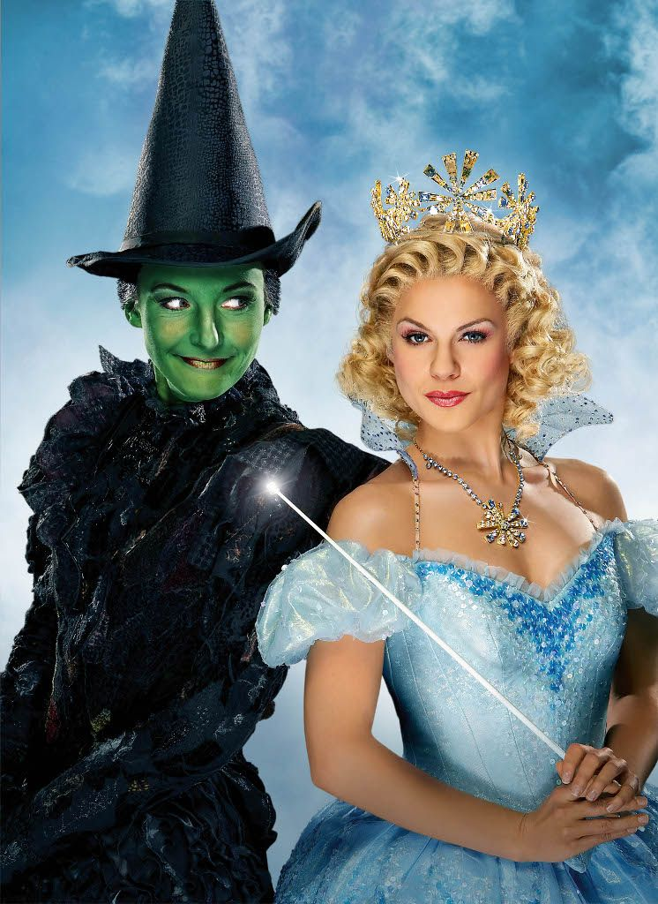
Chorus: main part of the song / lyrics normally repeated in the chorus, most catchy bit.
Unison: Where 2 or more people are singing the same melody in this case it's the two soloists.
Structure

Slide 16
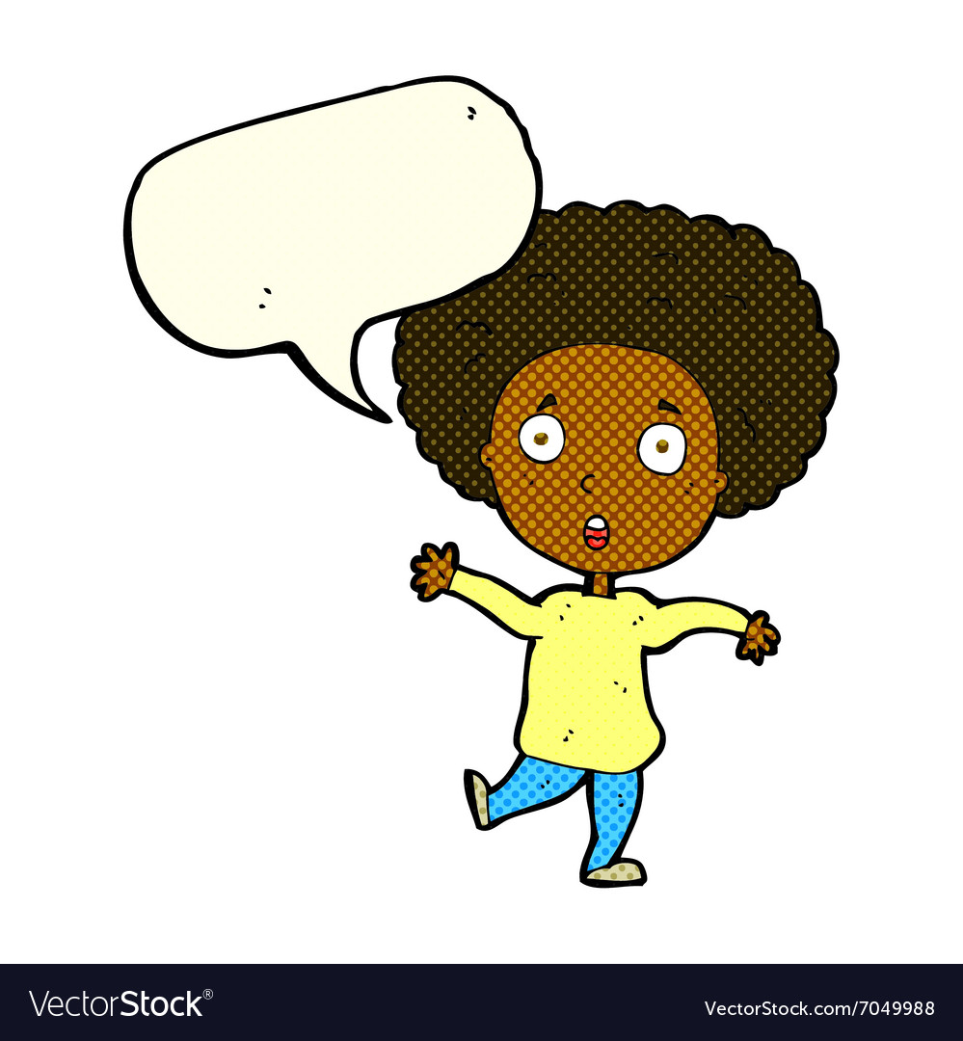
Recitative: is a style of delivery (much used in operas, oratorios, and cantatas) in which a singer is allowed to adopt the rhythms and delivery of ordinary speech.
Homophonic chordal: all instruments are playing the same rhythm but different notes ie chords.
Structure

Slide 17
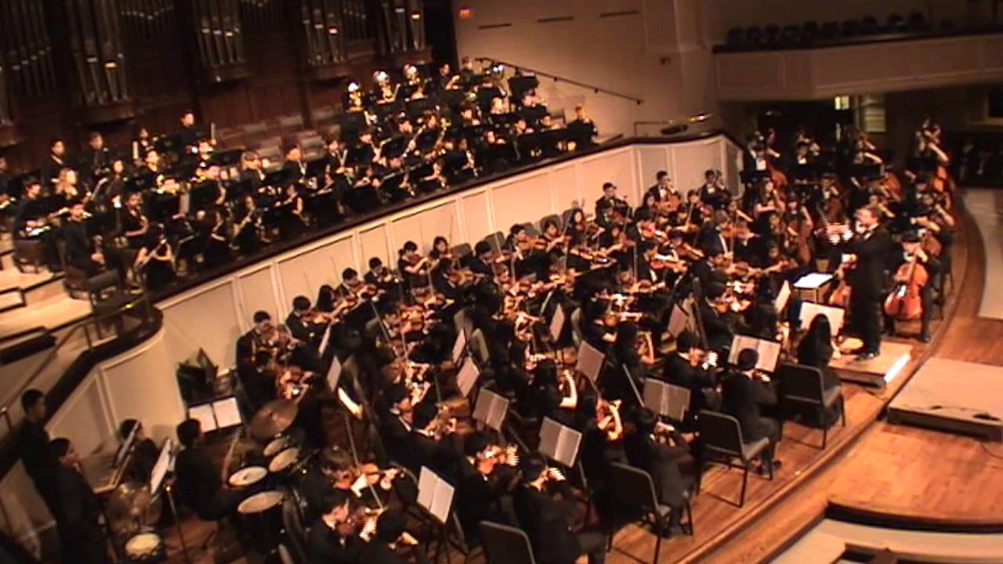
Climax: biggest part of song.
Higher register: higher part of the voice.
Structure

Slide 18
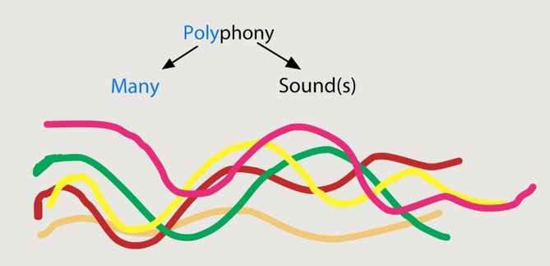
Tutti: full orchestra
Ensemble chorus: group of singers / choir - not just the soloists, they may be other people in play.
Counterpoint: combining lots of different melodies - basically polyphony.
Maestoso: Majestically!
Structure

Slide 19
Texture

Slide 20
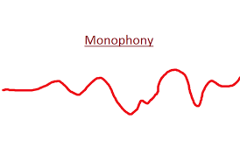
Texture
The opening shows a sparse texture with punctuating instrumental chord stabs (e.g. bar 1) with some monophonic unaccompanied bars.
Sparse: thinly dispersed or scattered.

Slide 21
Texture
In the verses there is a melody and accompaniment or melody-dominated homophony texture where the singer is accompanied by chords in the orchestra.

Slide 22
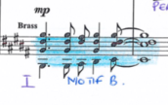
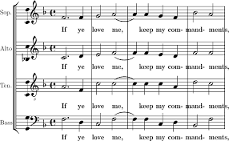
Texture
There are homophonic chordal moments (e.g. bar 132).
Homophonic chordal: iis a texture where there is a "sameness of rhythm in all parts" or "very similar rhythm" as would be used in simple hymn or chorale settings. Homorhythm is a condition of homophony.

Slide 23
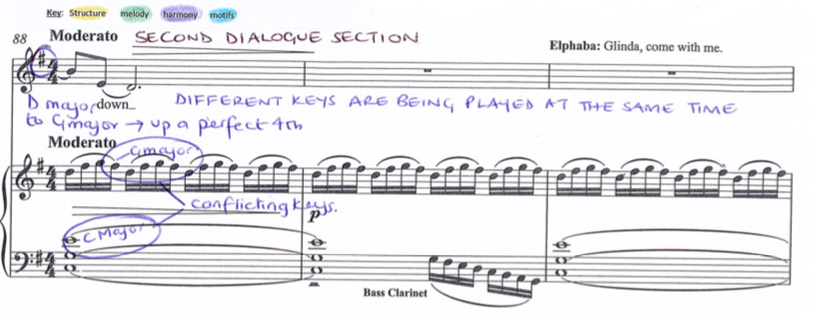
Ostinato accompaniment at bar 88 with repeated semiquavers.
Texture

Slide 24
Elphaba and Glinda usually sing separately but sometimes sing together in unison (e.g. bar 101) or in harmony such as thirds (e.g. bar 127).
The ending is contrapuntal with three different musical ideas with different lyrics (e.g. bar 168).
Texture

Slide 25
SUMMARY - Melody
The text setting is syllabic throughout with rhythms moving in a speech-like manner.
There is vocalisation at the end in bar 175 to the word ‘aah’.
The melody starts in a conjunct/stepwise manner.
Bars 6 and 7 show an ascending sequence.
The verse and chorus combine conjunct and wide angular leaps in the melodic line.
Leaps often feature a rising perfect fifth (e.g. bar 34). There are some exceptionally large leaps such as a compound perfect fourth (e.g. bars 39–40) and a compound perfect fifth (e.g. bars 140–141).

Slide 26
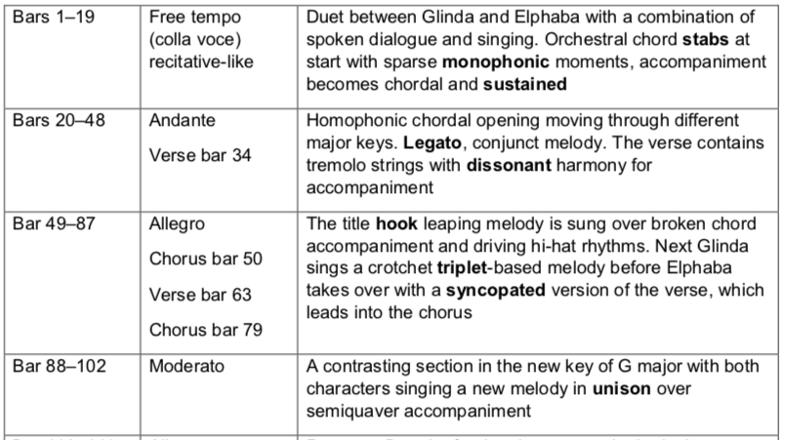

Slide 27
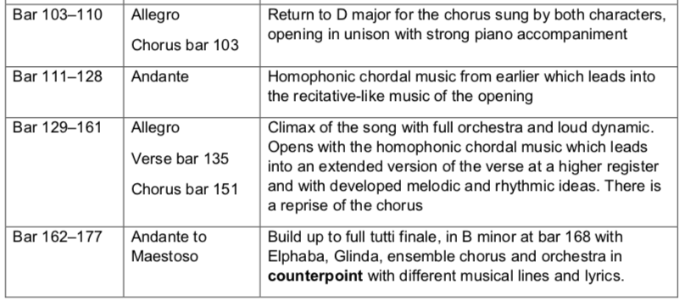

Slide 28
SUMMARY Texture
The opening shows a sparse texture with punctuating instrumental chord stabs (e.g. bar 1) with some monophonic unaccompanied bars (e.g. bar 3).
In the verses there is a melody and accompaniment or melody-dominated homophony texture where the singer is accompanied by chords in the orchestra.
There are homophonic chordal moments (e.g. bar 132).
Ostinato accompaniment at bar 88 with repeated semiquavers.
Elphaba and Glinda usually sing separately but sometimes sing together in unison (e.g. bar 101) or in harmony such as thirds (e.g. bar 127).
The ending is contrapuntal with three different musical ideas with different lyrics (e.g. bar 168).

