Slide 1
Defying Gravity Lesson 3
Tonality, Harmony, Tempo Metre and rhythm

Slide 2
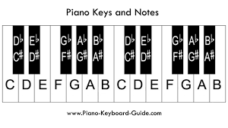
Tonality
Tonality
Tonality is to do with what scale or key you are using. Remember W W H W W W H ? This is a major scale. 1 2 3 4 5 6 7 1. If you start on D and use this formula (D E F# G A B C#)
Minor has a different formula - depending on which note you start on all keys / scales sound different and we have to know what different scales that the pieces we study use.

Slide 3
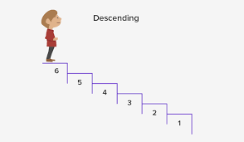
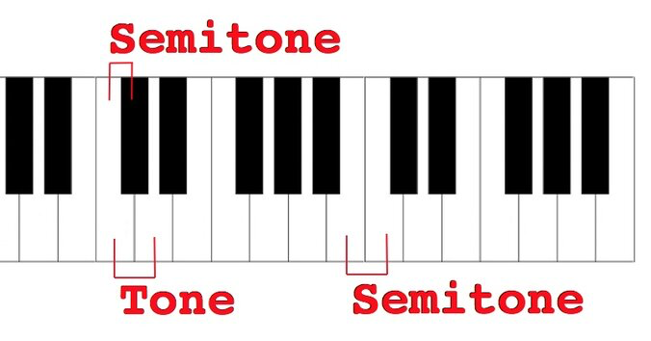
Tonality
In the opening the tonality is ambiguous with chromatic movement and unrelated chord progressions.
Ambiguous: not clear or decided.
Chromatic: large use of semitones.

Slide 4
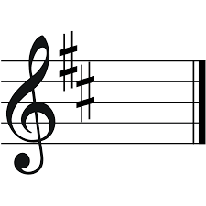
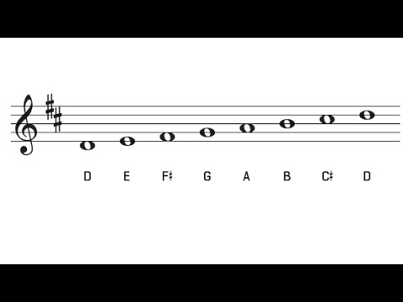
It is in D major!
.
Tonality
W W H W W W H

Slide 5
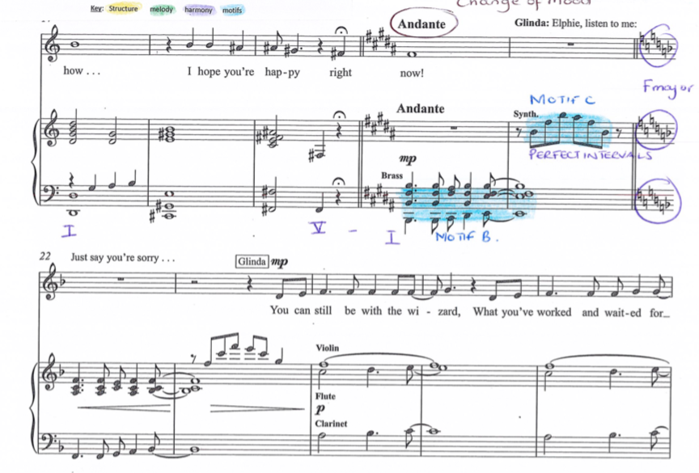
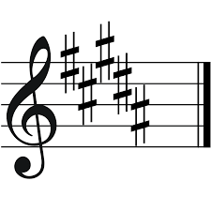
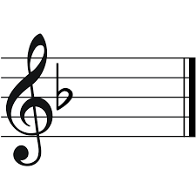
At bar 20 it is in B major for two bars before arriving in F major at bar 22.
Tonality

Slide 6
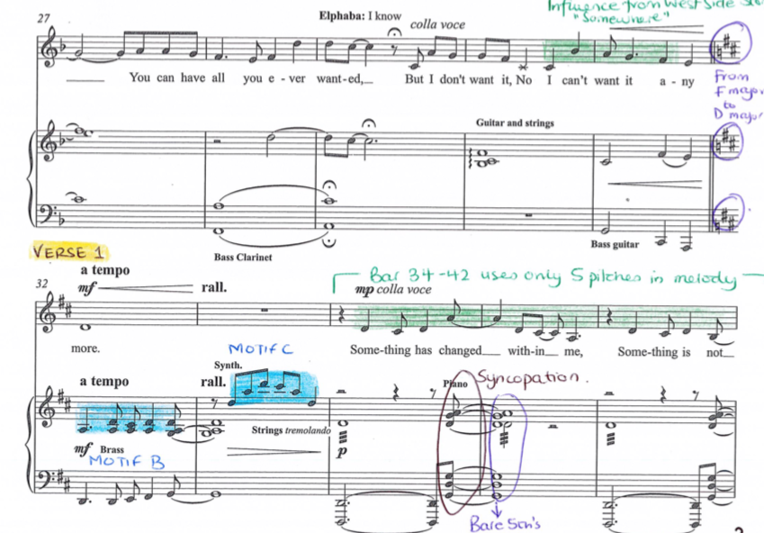
At bar 32 it arrives in the tonic key of D major for the verse. It remains in D major until bar 88
Tonality

Slide 7
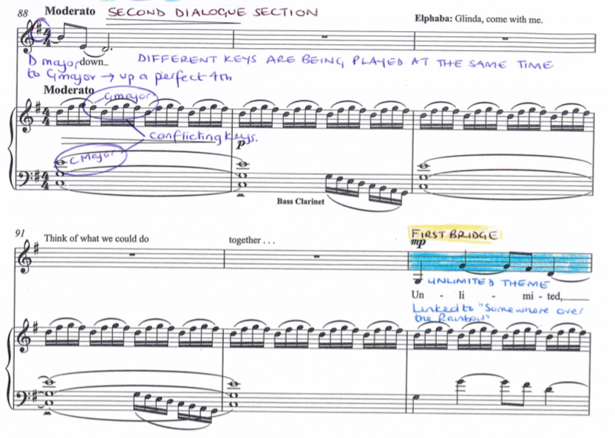
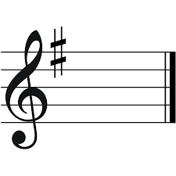
At bar 88 it moves to G major
Tonality

Slide 8
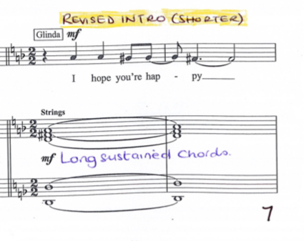
At bar 115 it returns to the chromatic melody of the opening.
Tonality
Chromatic: use of semitones - not in a major or minor key.

Slide 9
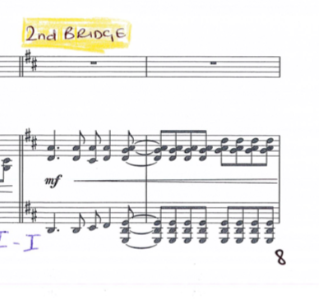
At bar 132 it returns to the tonic key of D major.
Tonality
Tonic:The tonic can be defined as the natural “resting place” of the music. It's possible that a melody will both start and end on the tonic, for a sense of “completeness”. It is the 1st note in the scale you are using - the ‘1’
Chromatic: use of semitones - not in a major or minor key.

Slide 10
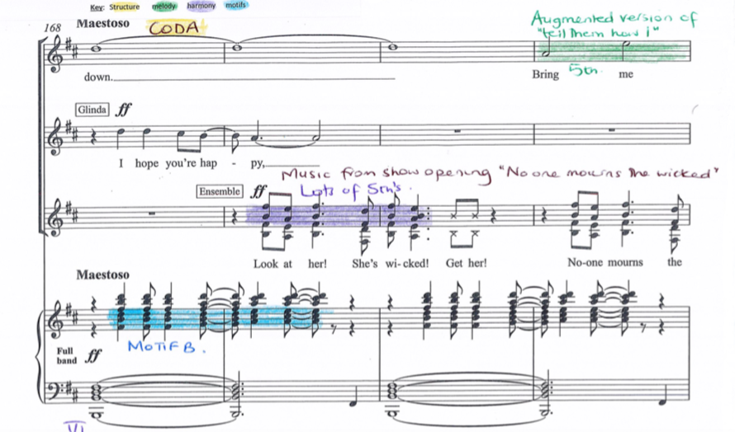
Tonality
For the final Maestoso section, bar 168 it is in B minor until we finish on a chord of D major.

Slide 11
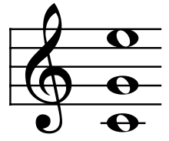
Harmony
Harmony

Slide 12
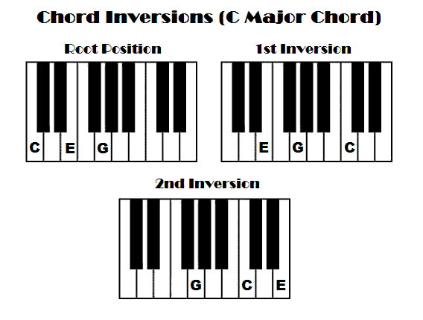
Harmony
Chords are in root position.
Chord progressions are often unrelated and in the opening we can see shifts downwards in parallel semitones. For example, a D chord to a C♯ minor chord to a C major chord.
Root position means that the lowest note of your chord is the root of the chord. For example if you are playing a C major chord, C would be the root. So the lowest note you would be playing is C. The next note would be the third, a major third to be exact.
Semitone: the smallest interval used in classical Western music, equal to a twelfth of an octave or half a tone. One step on the keyboard.

Slide 13
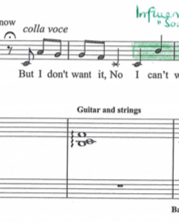
Harmony
There is some use of dissonance (e.g. bar 30).
1 2 3 4 5 6 7
Usual triad chord
1 2 3 4 5 6 7
Dissonant chord

Slide 14
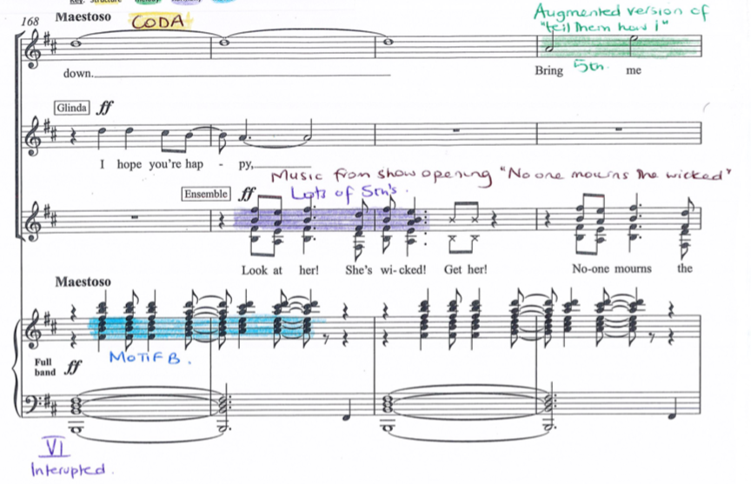
At the end there is a pedal at bar 168.
Harmony
Pedal: The term "pedal point" describes. a note, usually in the bass, sustained or continually repeated for a period of time while the harmonies change around it.

Slide 15
Tempo Metre Rhythm
Music’s pattern in time.
The speed of the pulse
How many beats in a bar / what type of beats these are.

Slide 16
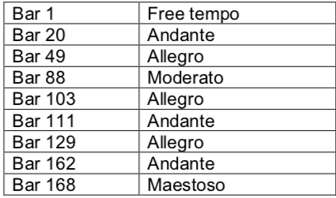
Tempo
Numerous tempo changes
Andante | moderately slow tempo (so quite slow)
Allegro | Fast
Moderato | Moderate pace (medium)

Slide 17
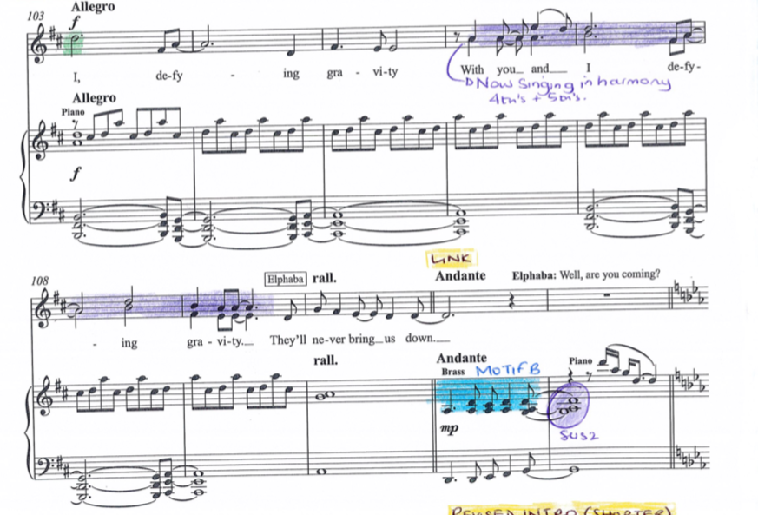
Tempo
There are rallentandos used particularly at the end of sections to go from Allegro to Andante. Sometimes there are ralls followed by an a tempo. There is also a rall used at the end of the piece.
A tempo: return to normal tempo
Rallentando: slow down tempo

Slide 18
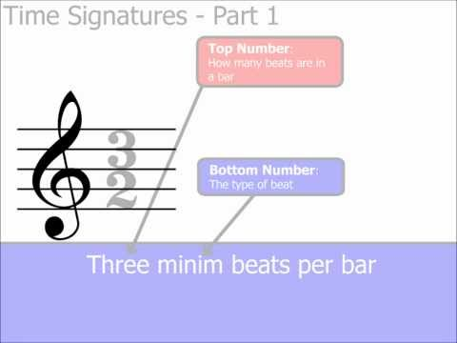
The time signature changes from 3/2 triple time to 2/2 duple time in the opening section and remains there until bar 88 where it changes to 4/4 quadruple time. At bar 115 it returns to 2/2 duple time.
Metre
Semibreve (lasts for 4 beats)
minim (lasts for 2 beats)
Crotchet (lasts for 1 beat)
Quaver (lasts for half a beat)

Slide 19
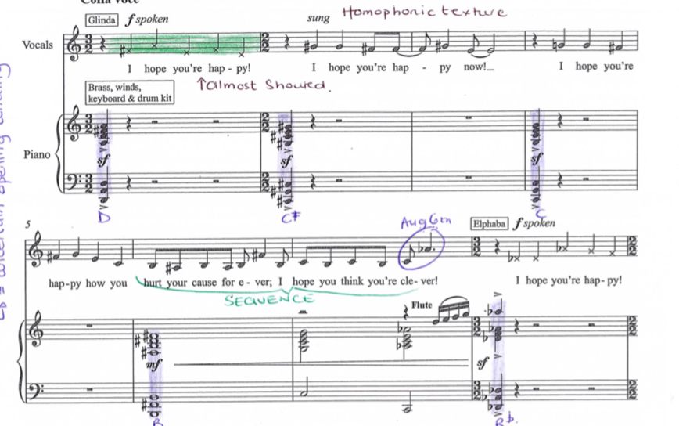
Metre

Slide 20
Rhythm
Syncopation is frequent throughout (e.g. bars 67–70).
Syncopation: weaker beats are emphasised.
Frequent: when something happens many times.

Slide 21
Rhythm
Dotted rhythms are used throughout. For example, in bar 82 on the word ‘gra-vi-ty’.
Dotted rhythm: sounds like long short long short for duration of notes.

Slide 22
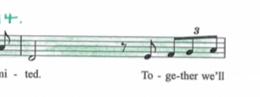
Rhythm
Triplets are used. These are both quaver triplets (e.g. bar 96) and crotchet triplets (e.g. bar 60).

Slide 23
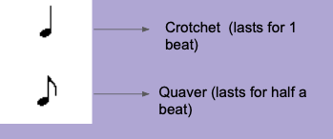
Rhythm
Rhythms are predominantly crotchet and quaver based, although there are some notes of longer duration particularly at the ends of phrases.

Slide 24
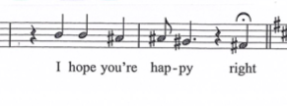
Rhythm
Each phrase starts with an off-beat entry after a crotchet rest (e.g. bar 15).
Crotchet rest: a rest that lasts for 1 beat.

Slide 25
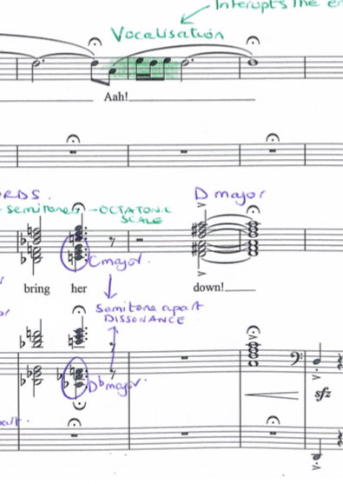
Rhythm
Pause marks are used to lengthen and give freedom to longer rhythms, for example at the end (e.g. bars 174 and 176).
Rests are often used to break up phrases.

Slide 26
Summary

Slide 27
