Slide 1
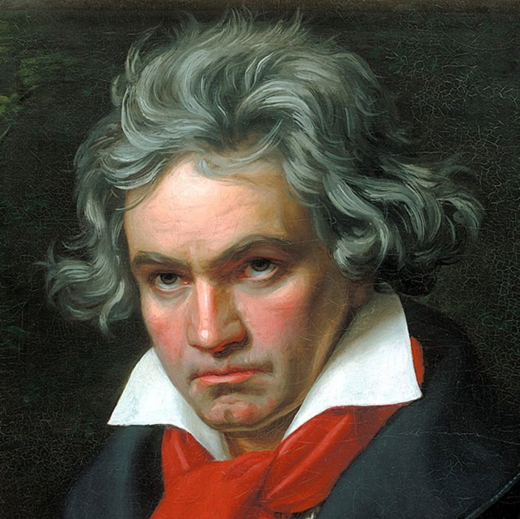
Ludvig van Beethoven 1770 - 1827
Pathétique Sonata in c minor
1st movement
The context

Slide 2
Background information and performance circumstances
Ludwig van Beethoven was born in 1770 in the German city of Bonn.
As a young man he moved from Bonn to Vienna where he was chiefly known as a virtuoso pianist.
He played mainly in the houses of wealthy aristocrats, but he also gave grander-scale concerts.
Although he gave very few public concerts, he did stage a famous benefit concert on December 22, 1808 in the Theater an der Wien. This enormous event included both the Fifth and Sixth Symphonies; the Fourth Piano concerto; two movements from the Mass in C, a concert aria Ah! Perfido and the Choral Fantasia for orchestra, choir, vocal soloists and piano. The concert lasted for four hours!

Slide 3
The Pathétique Sonata
This piece was his eighth published sonata and was written between 1796 and 1799. It was dedicated to a Viennese aristocrat, Prince Karl von Lichnowsky. It was around the time of the Pathéthique Sonata that Beethoven's hearing began to deteriorate.
The French word pathétique means ‘moving’ or ‘emotional’ and it was used by the publisher in the first edition.
A sonata is a piece for solo instrument and contains three or sometimes four movements, each with a different tempo (speed).
Beethoven is regarded as one of the great composers of the Classical period together with Mozart and Haydn, both of whom he knew.
To a certain extent this piece shows early signs of the Romantic style to come. Beethoven’s piece is revolutionary in its extreme use of dynamics and unusual structure.

Slide 4
Beethoven’S Sketch Books
How can he help you to compose?

Slide 5
Beethoven’s composing method
We study ‘great’ composers for two reasons: firstly because we like their music and secondly because they can teach us how to write our own music.
We know that Beethoven spent months and often years composing and developing individual ideas – these ideas were eventually woven together to create a complete composition.
He kept his ideas in sketch books – he often used his ideas many years after he had first thought of them.
Over 10,000 pages of sketches survive!

Slide 6
What do the sketch books tell us?
There are several different types of sketch book:
Concept sketches - just brief ideas – clefs, key signatures, time signatures, sometimes a title and sometimes some harmony was added.
Synopsis sketches – ideas with elaborations of the themes, developments and possible continuations – often a single line of melody with a synopsis of the structure and content.
Continuity drafts – here he attempted to fit his ideas together and to establish continuity between sections – there were often several different juxtapositions of the material.
We can look at his methods and use them to compose music of our own, in our own style – whatever that might be!

Slide 7
Concept sketch: We can make a note of a clef, key or idea that we intend to use (from the Missa Solemnis)

Slide 8
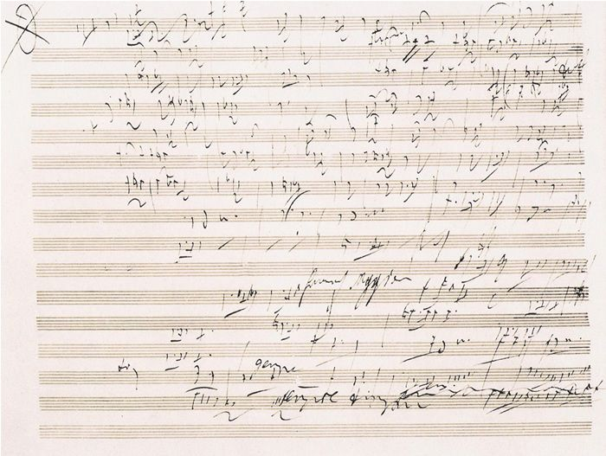
Synopsis sketch: We can note down chords sequences or melodies that we might use and/or combine (from a sketch for the eroica Symphony)

Slide 9
Continuity draft: We can compose different sections and then rearrange them to give the best structure (from the Moonlight Sonata, mvt 3)

Slide 10
Finally Beethoven created a finished ‘autograph score’ – only it often wasn’t finished and was covered with alternatives And Changes – luckily, we have Sibelius, Cubase or Logic to help us. (from THE missa Solemnis)

