Slide 1
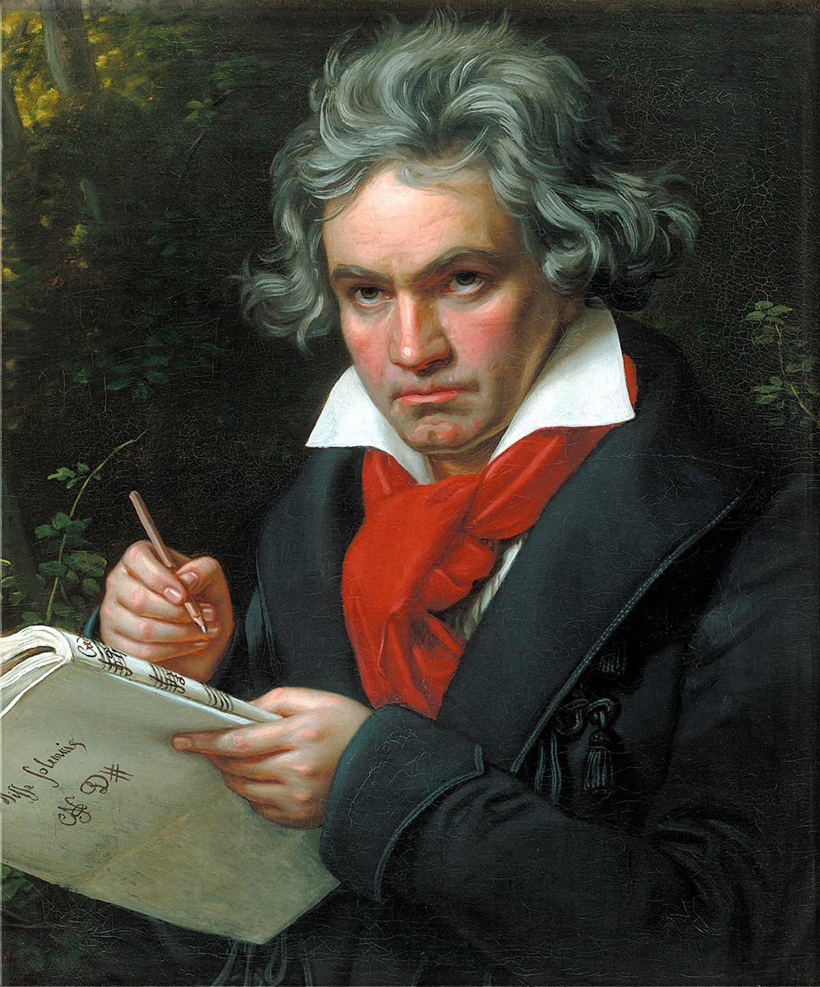
Ludwig Van Beethoven (1770-1827)
Sonata No.8 in C minor Op. 13, ‘Pathétique’
1st movement

Slide 2
Context – Ludwig Van Beethoven
Born in Bonn in 1770
He moved to Vienna where he established a reputation as a virtuoso pianist
He performed many of his own pieces in the salons of the wealthy aristocrats but he also gave grander-scale concerts
At this early stage of his career at the end of the 18th century, he performed his first two piano concertos (pieces for piano and orchestra). He also wrote piano trios (pieces for piano, violin and cello). Much of his greatest music at this time and later was contained in his piano sonatas
It was around the time of the Pathétique Sonata that his hearing began to deteriorate, though the problem wasn’t severe enough yet for him to give up performing. The situation worsened rapidly in the next few years. In later years he was able to continue composing despite his hearing problems.

Slide 3
Piano Sonata
During and after the Classical period the term sonata was used for works in 3 or 4 movements written for either piano alone or for a solo instrument with piano
Beethoven wrote 32 piano sonatas

Slide 4
The Pathétique Sonata
No.8 is in 3 movements and was published in 1799 under the title Grande Sonate Pathétique.
The french word pathétique means ‘passionate’ or ‘emotional’ and reflects a feature of the music that seems to anticipate the Romantic style of the 19th century
It was dedicated to one of the Viennese aristocrats, Prince Karl von Lichnowsky
Beethoven knew Mozart’s sonata in C minor, K 457, which had been written around 15 years earlier, and he would have been influenced by that composition. Beethoven’s piece is more revolutionary still in its extreme use of dynamics and unusual structure.

Slide 5
The Piano
When Beethoven wrote this piece at the end of the 18th century, the piano had almost completely replaced the harpsichord as the keyboard instrument of choice for the home and concert hall
At the time the instrument was often known as the fortepiano. Whether you call it that or the more modern pianoforte, the clue to the popularity of the instrument is in its name.
It was now possible to play using all kinds of dynamic levels just by altering the pressure of the fingers on the keys.

Slide 6
The Piano
Mozart and Haydn had started to use dynamic markings, but Beethoven was one of the first to make extensive use of all kinds of dynamic possibilities.
This sonata has frequent crescendos, diminuendos and numerous other performance markings.
The sustaining pedal was coming into use at the time and was sometimes worked by the knees instead of by the foot.
It is important to note that in the original edition of the music there were no pedal markings, although Beethoven would almost certainly have used some kind of sustaining system in his own performances.

Slide 7
The ‘Pathétique’ Sonata performed on a reproduction Pianoforte

Slide 8
SONATA FORM
EXPOSITION | FIRST SUBJECT TRANSITION SECOND SUBJECT CODETTA | Tonic key Modulates to related key Dominant/ related key. If tonic is in a minor key – usually goes to relative major Ends in related key
DEVELOPMENT | Ideas from the Exposition are transformed | Modulations to more distant keys
RECAPITULATION | The music from the Recapitulation returns Ends with a CODA | 2nd subject now in tonic key Coda in tonic

Slide 9
Sonata Form in 1st Movement of the ‘Pathétique’
INTRODUCTION |  | C minor modulating briefly to E♭major
EXPOSITION | First subject Transition Second Subject (1st part) Second Subject (2nd part) Codetta | C minor Modulates to B♭major Begins in the unexpected key of E♭minor Begins in the E♭major (relative major) E♭major
DEVELOPMENT | Slow Introduction material Transition material Octave figure from 1st Subject bass | G minor E minor D major, G minor, dominant preparation (G pedal)
RECAPITULATION | First subject Second Subject (1st part) Second Subject (2nd part) Coda – slow introduction material & final reference to 1st subject | C minor Unexpectedly in F minor Now in tonic key C minor C minor

Slide 10
Harmony
The music features many chromatic chords, especially diminished sevenths (e.g. halfway through bar 1). These serve to heighten the drama of the music.
There are distinctive perfect cadences at the end of the movement.
There is an interrupted cadence in the introduction at bar 9.

Slide 11
Melody
The music of the slow introduction is based on a short (six note) motif, first heard at the beginning. This is used as a basis for most of the introduction, sometimes reduced to five notes, and sometimes with the second last note rising instead of falling.
There are a number of scalic passages, such as the descending chromatic scale at the end of the introduction. The first subject theme from bar 11 of the allegro is built on an ascending scale of the tonic key C minor, but with a major third (E). Notice the distinctive augmented second from A♭ to B♮.
Melodic lines also include arpeggios and broken chords (e.g. bars 29–30).
Ornaments are an important feature of the second subject in particular. These include acciaccaturas at bar 53 etc., mordents shortly afterwards, and trills just before the recapitulation.

Slide 12
Texture
The slow introduction includes many passages of homophonic (chordal) writing (e.g. bar 1).
The right hand plays in octaves later in the introduction (e.g. bar 5).
There is a long descending monophonic passage in the right hand leading into the recapitulation.
The second subject material features melody and accompaniment style – you can also call this homophony (or melody-dominated homophony).
There are examples of two-part music with broken chords in the second idea of the second subject (e.g. bar 93).
There is a brief passage in thirds where the trills are (e.g. bars 181–187).

Slide 13
Tempo/Metre/ Rhythm
The introduction is marked grave (very slow).
The time signature is common time.
Dotted rhythms are an important feature of the introduction (e.g. bar 1).
There are some very rapid notes, including septuplets.
The main allegro di molto e con brio section, (very fast with vigour), is in alla breve time (or cut common time) – a fast two in the bar.
Continuous quavers are a distinctive feature of the accompaniment of the first subject.
Staccato crotchets are important in the right hand of the first subject.

