Slide 1
Student Voice: mental health activity day
Assembly

Slide 2
Welcome:
https://youtu.be/_-B1tTdWSCQ

Slide 3
Student Voice: Quiz Time!
Mental Health
Activity Days

Slide 4
Simple rules
We have eight questions for you.
Each question has three possible answers A, B and C.
If you think the answer is A raise one hand.
If you think the answer is B raise two hands.
If you think the answer is C stand up.
You will have 15 seconds to answer each question.
Keep count of how many you get right.

Slide 5
A) 35 minutes B) 50 minutes C) 60 minutes
1. How many minutes of exercise should teenagers get per day?

Slide 6
If you think the answer is A raise one hand. If you think the answer is B raise two hands. If you think the answer is C stand up.

Slide 7
If you are standing up, well done! Teenagers need c) 60 minutes of exercise every day.

Slide 8
2. If you exercise regularly, how much does your anxiety reduce by (on average)?
40%
60%
80%

Slide 9
Two hands? Correct!
On average regular exercise can reduce your anxiety by B) 60%.

Slide 10
3. Which juice is the healthiest?
Apple
Cranberry
Carrot

Slide 11
B) Cranberry is the healthiest choice as it has the least sugar.

Slide 12
a) Fish B) Steak C) Chicken
4. Which of the following foods helps you to sleep better?

Slide 13
A) Fish may help improve sleep as it is a good source of vitamin D and omega-3, two nutrients that help regulate serotonin.

Slide 14
5. How much rest should you get in between high intensity training?
10 seconds – 1 minute
30 seconds – 5 minutes
10 – 15 minutes

Slide 15
B) You should rest for between 30 seconds and 5 mins when interval training.

Slide 16
A) 8 hours B) 9 hours C) 10 hours
6. How many hours of sleep should teenagers regularly get?

Slide 17
Teenagers need an average of B) 9 hours sleep per night.

Slide 18
7. How long should you wait before you go to bed after getting off electronic devices?
Straight away
30 minutes
1 hour

Slide 19
You should stop looking at electronic devices at least b) 30 minutes before bed.

Slide 20
A) 15 minutes B) 30 minutes C) 1 hour
8. How much time a day should you spend on yourself (self-care)?

Slide 21
You should spend A) 15 minutes a day looking after yourself.

Slide 22
How many did you get right? We hope you learnt something today.

Slide 23
Student Voice: 5-ways to improve your mental health
Mental Health
Activity Days

Slide 24
We would like to challenge you to make just one of the following small changes to your everyday life which will improve your mental and physical health.
Which one will you choose?

Slide 25
Challenge 1: Go to bed 15 mins earlier than usual all week.
Having a set bedtime will help you to get into a better mood and you will be able to concentrate better.

Slide 26
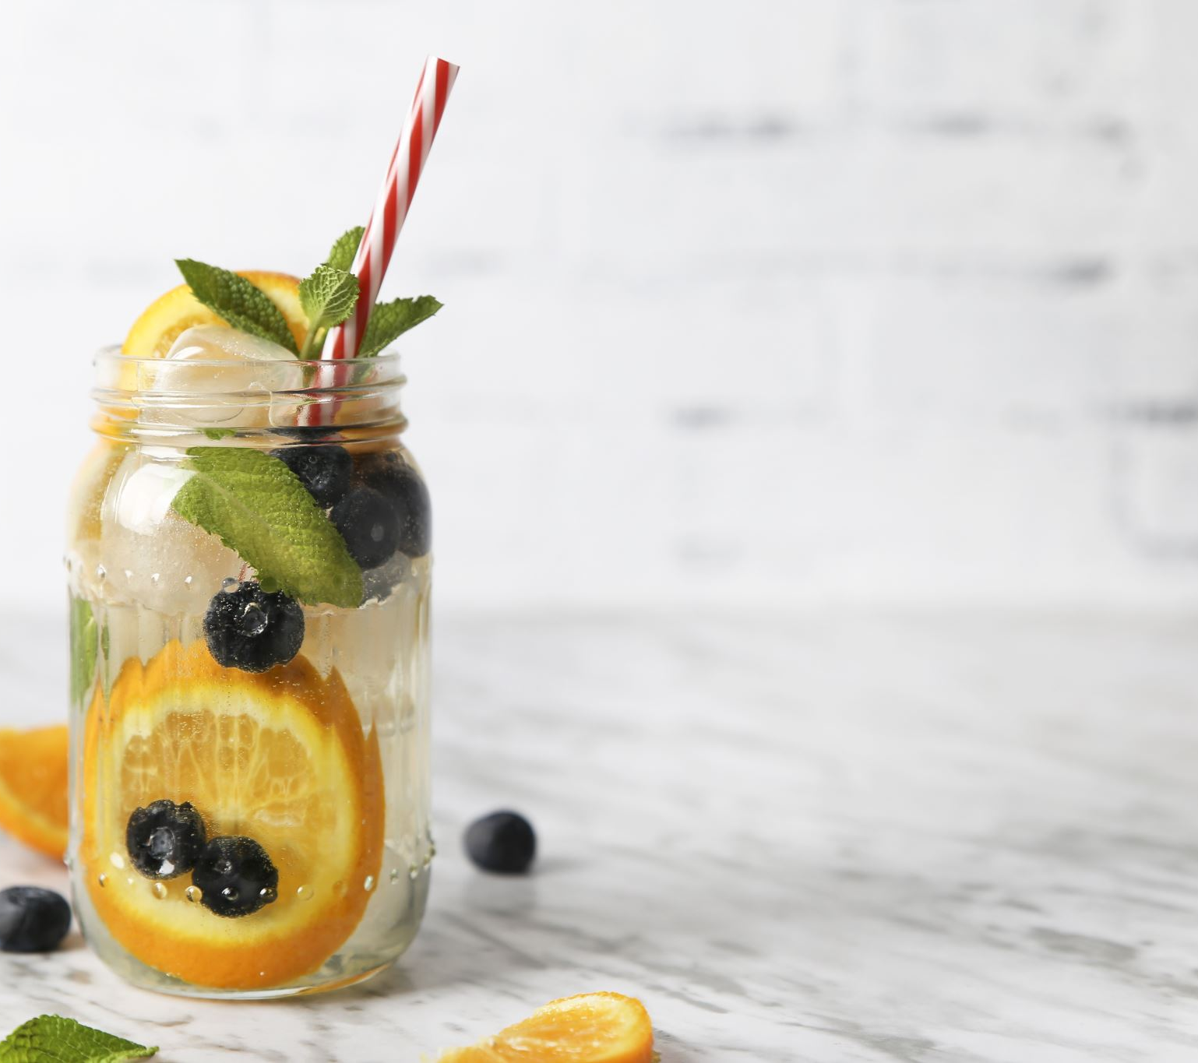
Drinking water instead of fizzy drinks reduces your sugar intake.
CHALLENGE 2:
REPLACE A FIZZY DRINK WITH A GLASS OF WATER TWICE THIS WEEK.

Slide 27
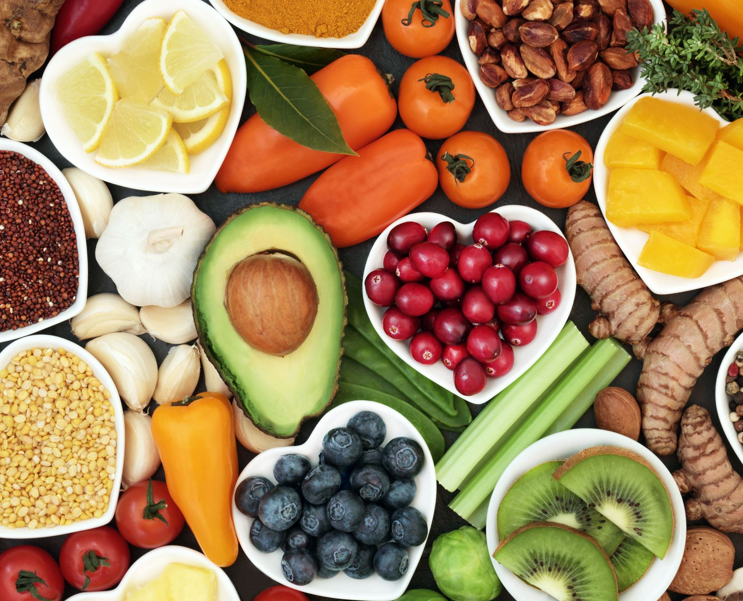
Having at least five different fruits and vegetables a day can improve your blood flow, maintain your energy levels, increase your concentrate and improve your life expectancy!
Challenge 3:
Eat three more fruits/vegetables each day this week.

Slide 28
Research shows that the more you walk, the more you improve your muscles and your mental health.
CHALLENGE 4:
Walk an extra 3000 steps this week

Slide 29
Challenge 5: stop looking at screens 20 minutes earlier than usual.
Watching a screen (TV, computer or phone) one hour before going to bed can negatively affect your sleep pattern.

Slide 30
Which challenge will you take?
Challenge 1: Go to bed 15-minutes earlier than usual all week.
Challenge 2: Replace one fizzy drink with a glass of water twice this week.
Challenge 3: Eat 3 more fruits / vegetables every day this week.
Challenge 4: Walk an extra 3000 steps this week.
Challenge 5: Stop looking at screens 20mins earlier than usual.
Show of hands for each challenge.

Slide 31
WHICH CHALLENGE IS THE MOST POPULAR?
THANK YOU FOR TAKING PART IN OUR CHALLENGE

