Slide 1
Promoting Sustainable Southwark Schools SSLP Student Voice 22/23: Sustainability

Slide 2
Our Purpose
To establish consistent and efficient recycling in Southwark Schools
To educate students and staff about the importance of being sustainable in schools and in everyday life
To spread awareness about the climate crisis

Slide 3
What we offer
An assembly pack on the importance of recycling that includes:
Video
Summary leaflet
Quiz to assess your understanding
Reflection questions and action points to start implementing recycling in your school

Slide 4
Project Video
https://www.dropbox.com/s/fg1g6rq70pdzlgo/SSLP%20-%20Waste%20Less_%20Sustainability%20Project.mov?dl=0

Slide 5
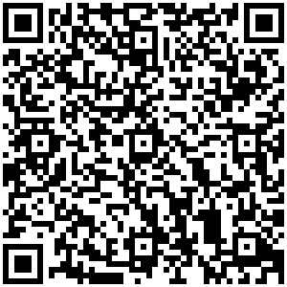
Promoting Sustainable Southwark Schools
Summary leaflet
Our aims:
Implementing consistent and effect recycling practice
What can be recycled in Southwark?
No need to separate different recyclable items
Paper, card, carboard, glass bottles, jars, cans, tins, food and drinks cartons etc.
What cannot be recycled in Southwark?
Paper cups, paper plates, paint tins, carrier bags, sweet and crisps wrappers, electrical items, toys etc.
QR Code for the leaflet:
Limitations of recycling
Recycling involves the use of energy
Not all materials are recyclable
Materials can be recycled only a limited number of times due to degradation
Benefits of recycling
Reduces the use of raw materials
Reduces pollution
Reduces greenhouse gas emissions and carbon footprint
How can you limit waste?
Do not buy things you do not need
Recycle, repair and reuse
Avoiding purchasing carrier bags
Try printing A5 or double sided

Slide 6
Test your knowledge with our Kahoot Quiz
https://create.kahoot.it/share/sslp-waste-less-recycling-project-video-quiz/5d451264-9386-484b-a189-29bc606c8677
Notes:
https://create.kahoot.it/share/sslp-waste-less-recycling-project-video-quiz/5d451264-9386-484b-a189-29bc606c8677

Slide 7
Reflection questions
Does your school have recycling bins?
Are the recycling bins in your school clearly labelled?
Are the recycling bins in your school used effectively?
Does your school encourage reducing waste?
Does your school encourage the use of refillable water bottles?

Slide 8
Things you could do:
Talk to Senior Management in your school about implement changes like:
Investing in recycling bins
Investing in food waste bins for the canteen
Investing in recycled paper and books
Holding assemblies on sustainability
Holding repair workshops

Slide 9
Get recycling!

