Slide 1
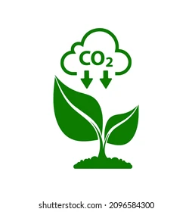
Promoting Sustainable Southwark Schools
Our aims:
Implementing consistent and effective recycling practice
What can be recycled in Southwark?
No need to separate different recyclable items
Paper, card, carboard, glass bottles, jars, cans, tins, food and drinks cartons etc.
Please rinse before recycling
What cannot be recycled in Southwark?
Used paper cups, paper plates, paint tins, carrier bags, sweet and crisps wrappers, electrical items, toys etc.
Limitations of recycling
Recycling involves the use of energy
Not all materials are recyclable
Materials can be recycled only a limited number of times due to degradation
Benefits of recycling
Reduces the use of raw materials
Reduces pollution
Reduces greenhouse gas emissions and carbon footprint
How can you limit waste?
Do not buy things you do not need
Recycle, repair and reuse
Avoid purchasing carrier bags
Try printing A5 or double sided

