Slide 1
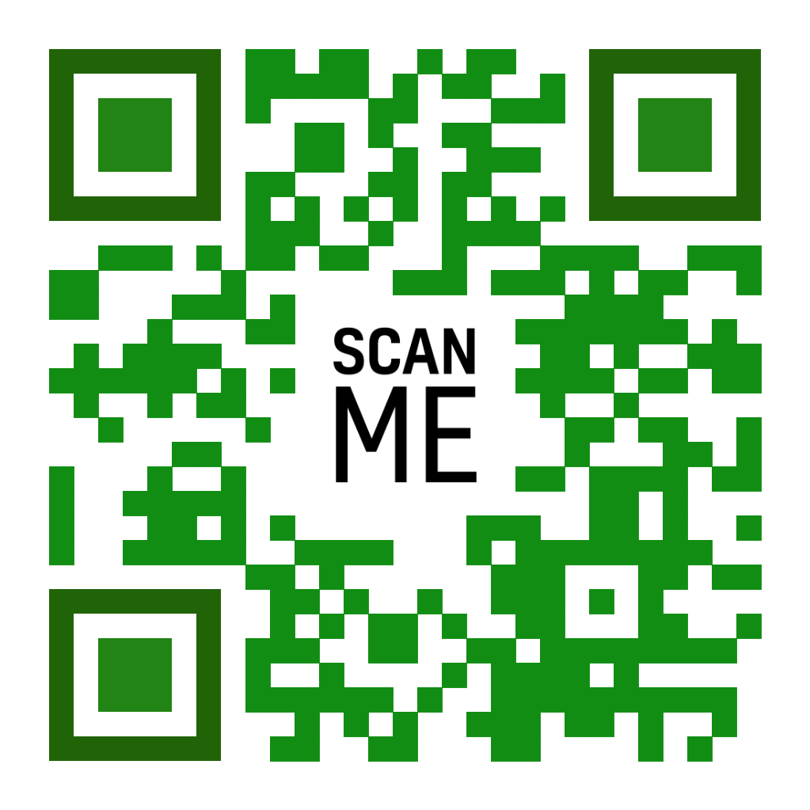
The Re-PROJECT is an important project for us as schools as we want to display to our communities, a sense of responsibility for a sustainable planet. To do this, we have created five REs: ReUse, ReRead, ReVive, RePurpose and RePlay.
We wanted to encourage people to have a more sustainable approach to products and not purchasing new things but instead resharing or repurposing.
Although this won't solve the issues we're facing, it will certainly help us take a step forwards to help protect our planet.
Notes:
At the end of paragraph #2 say: Hence the five REs

Slide 2
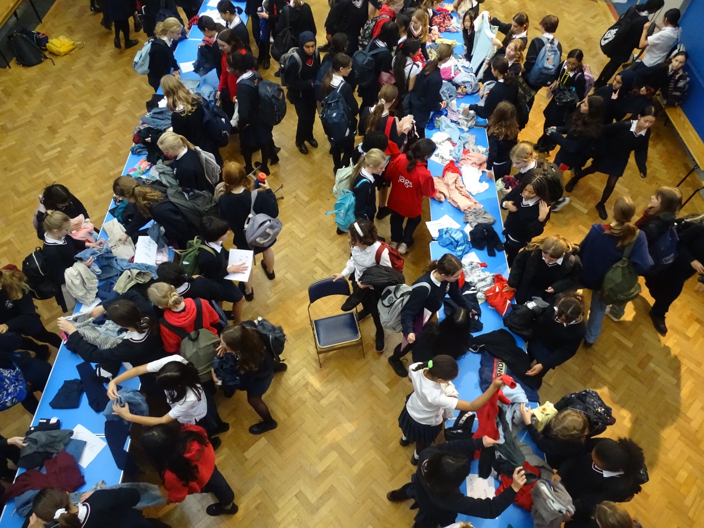
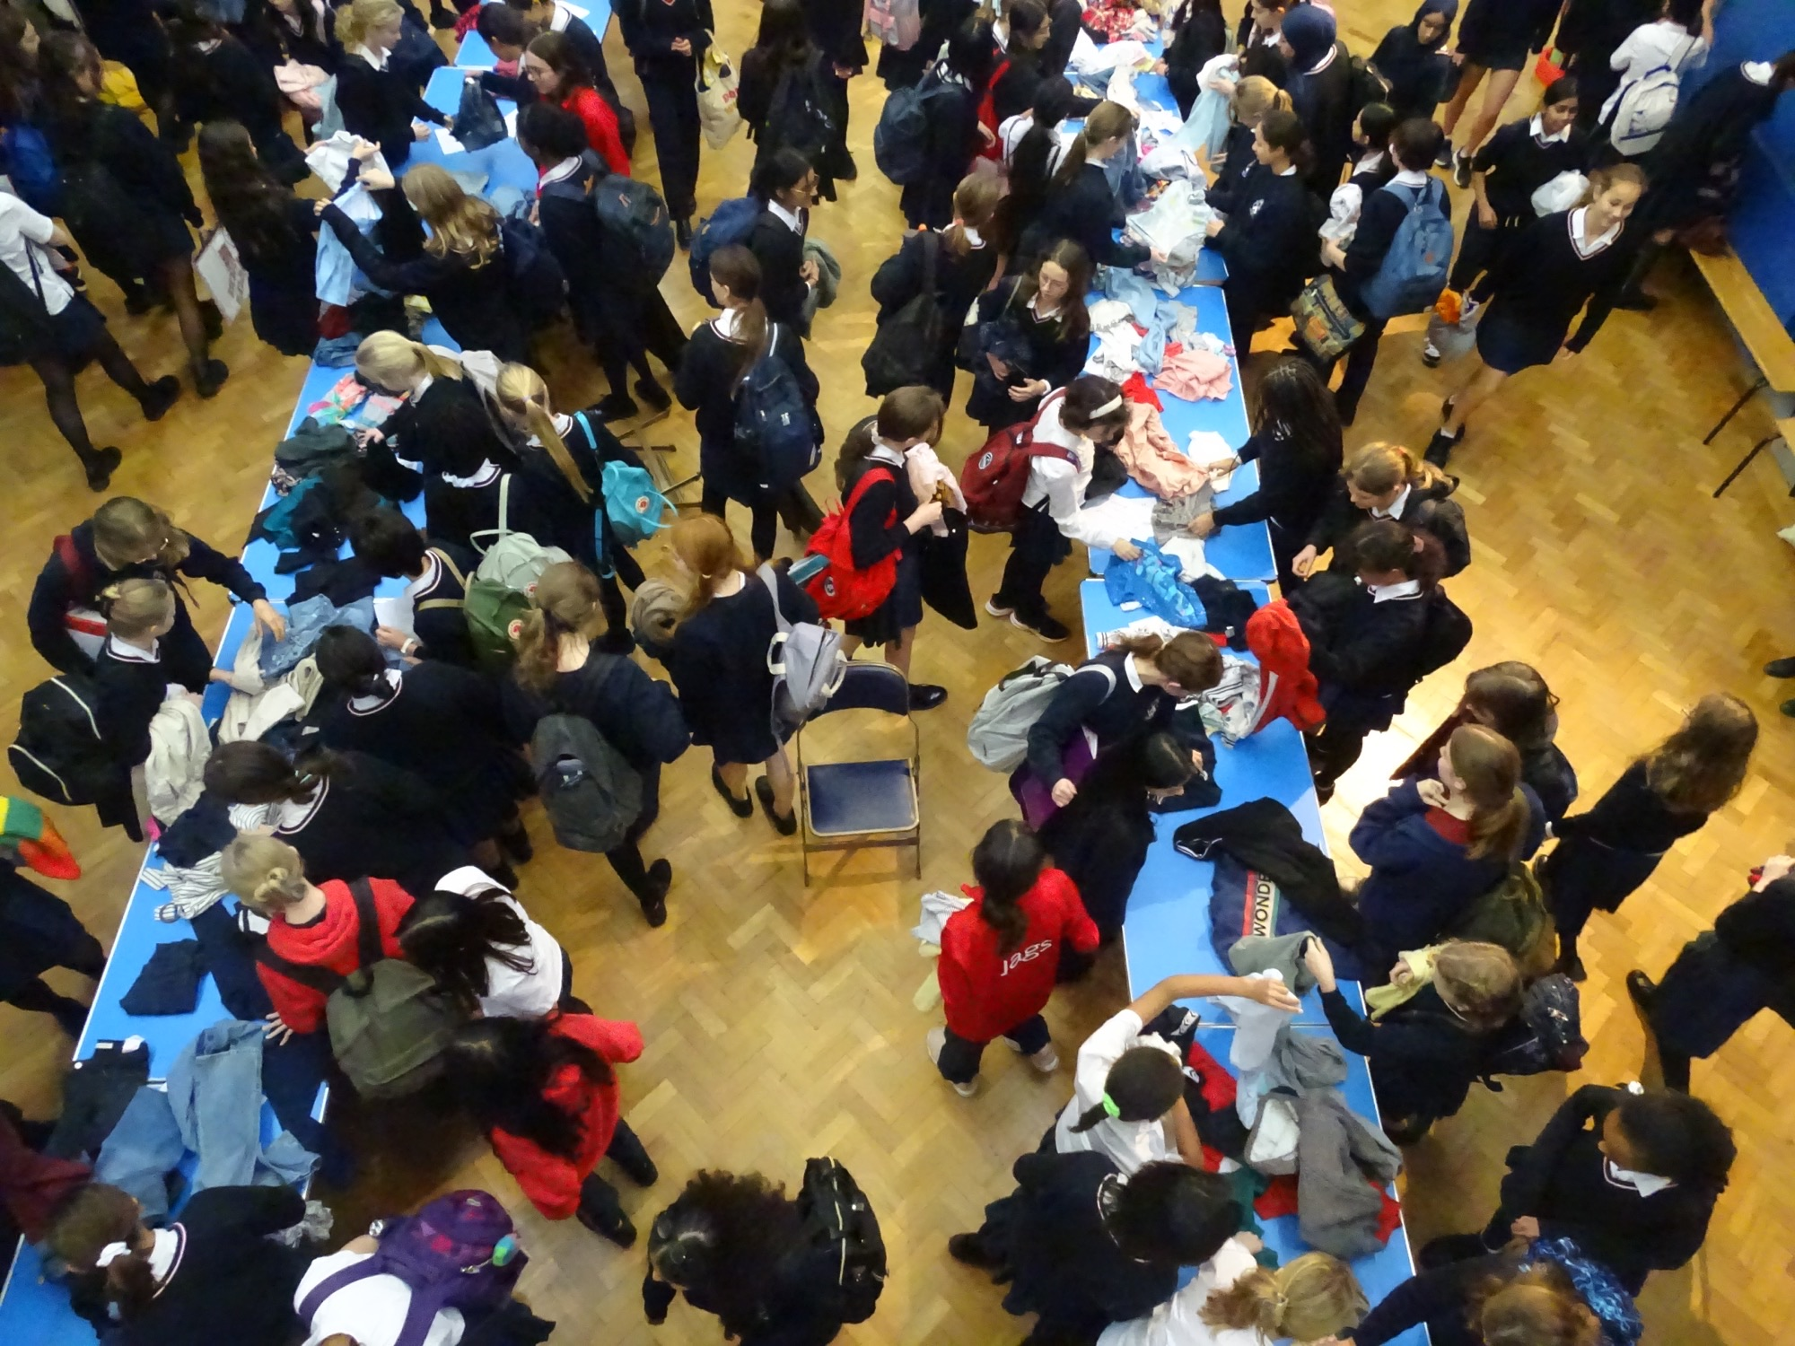
How to run a Clothes Swap
Choose a location​
This has to be a place that everyone in the area knows and is easily accessible. For example, the sports hall. Alternatively, a venue could be booked; this has to be done with enough notice though.
Spread the word
Start promoting the event through emails, posters and mention it during assemblies
Start setting up and find volunteers
In the chosen location (preferably a large space) get volunteers to set up tables and clothes racks. Get them ready to also take donations.
Start swapping
Once everything is ready, let people come in to start the swap
Enjoy your swap !
Resources
Tables
Clothes racks
Donation box
Clothes
Top tips
Ensure the students know what is appropriate to bring in
Get people to also donate hangers and clothes racks
Have different sections so it's easier to find things – clearly label them
Gather feedback on the event

Slide 3
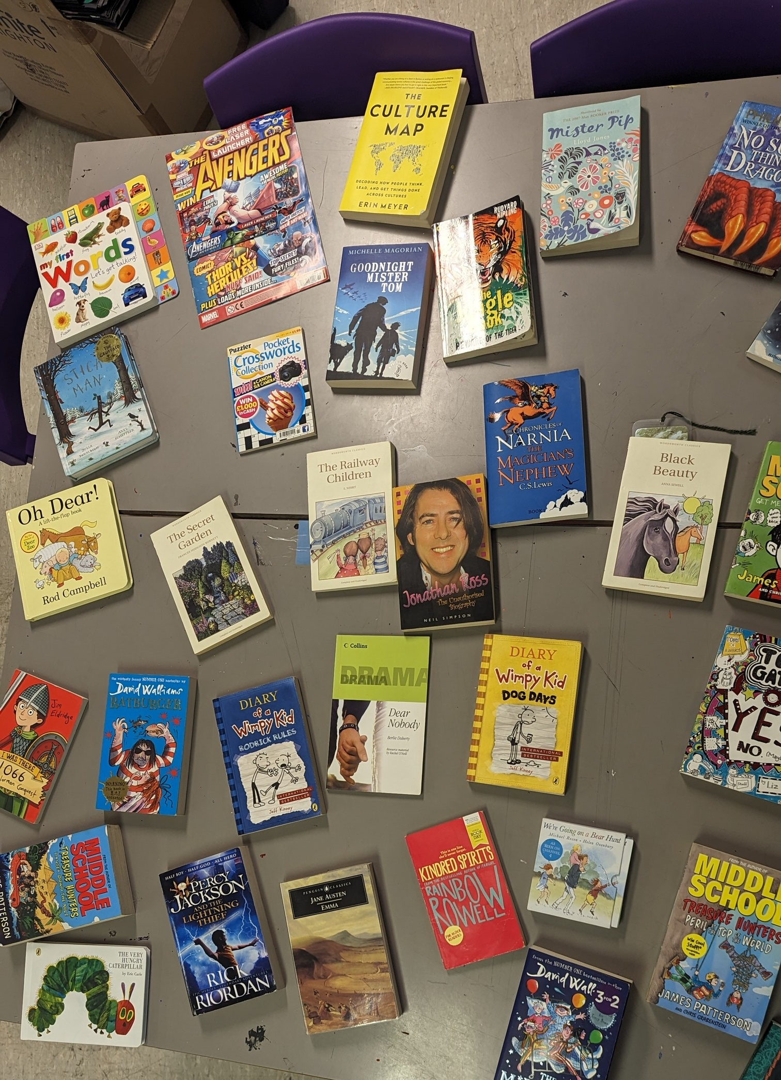
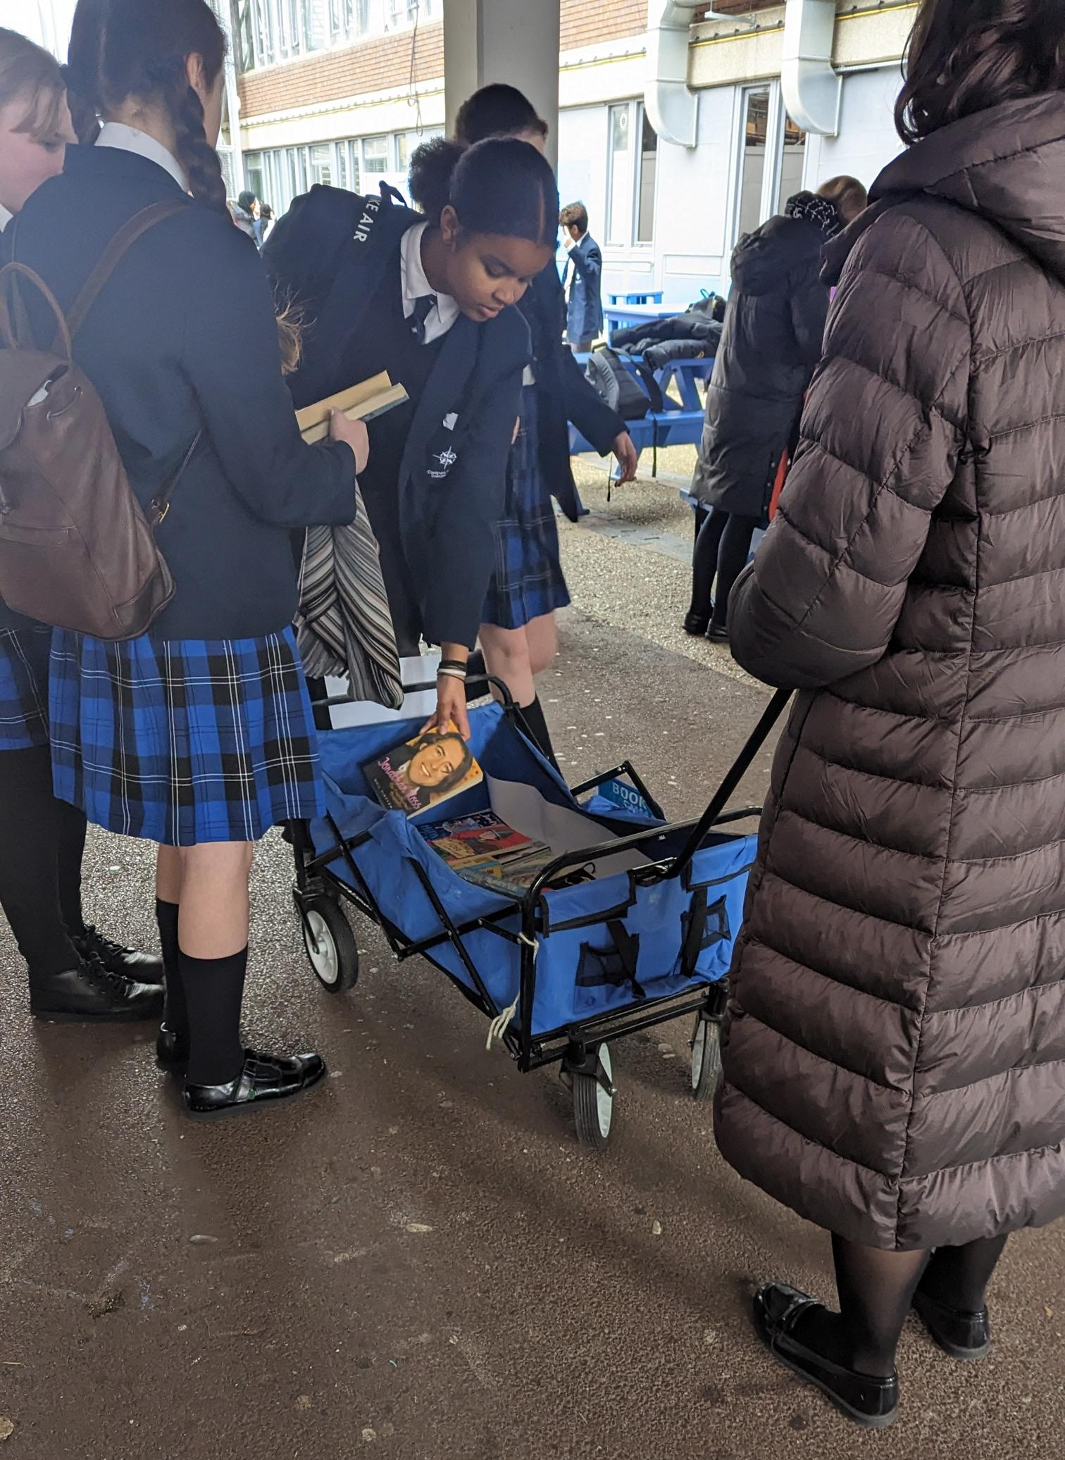
Resources
· Tables
· Refreshments
· Boxes to keep books
· Books
How-to run a Book Swap
Choose a location
This has to be a place that everyone in the area knows and is easily accessible. For example, the sports hall. Alternatively, a venue could be booked; this has to be done with enough notice though.
Find books
People attending the event can bring books they don’t like, don’t plan on reading or have just lying around. Depending on each school, they could be brought in a couple of days before the event or the day of.
Get the word out
This can be done through posters around the school, advertisements on the school’s social media accounts, giving letters to students, notices during lesson or sending announcements out.
Arrange the books
In a room, put the books on display. Alternatively, a station could be set up outside. The books should be arranged in categories (when possible) to make it easier for people to find what they are looking for.
Enjoy your swap!
Top tips
· The entry to get books could be either free or through a ticket, depending on the school
· If a location cannot be found, an alternative would be to put the books into a trolley and carry them around – this could get even more people involved

Slide 4
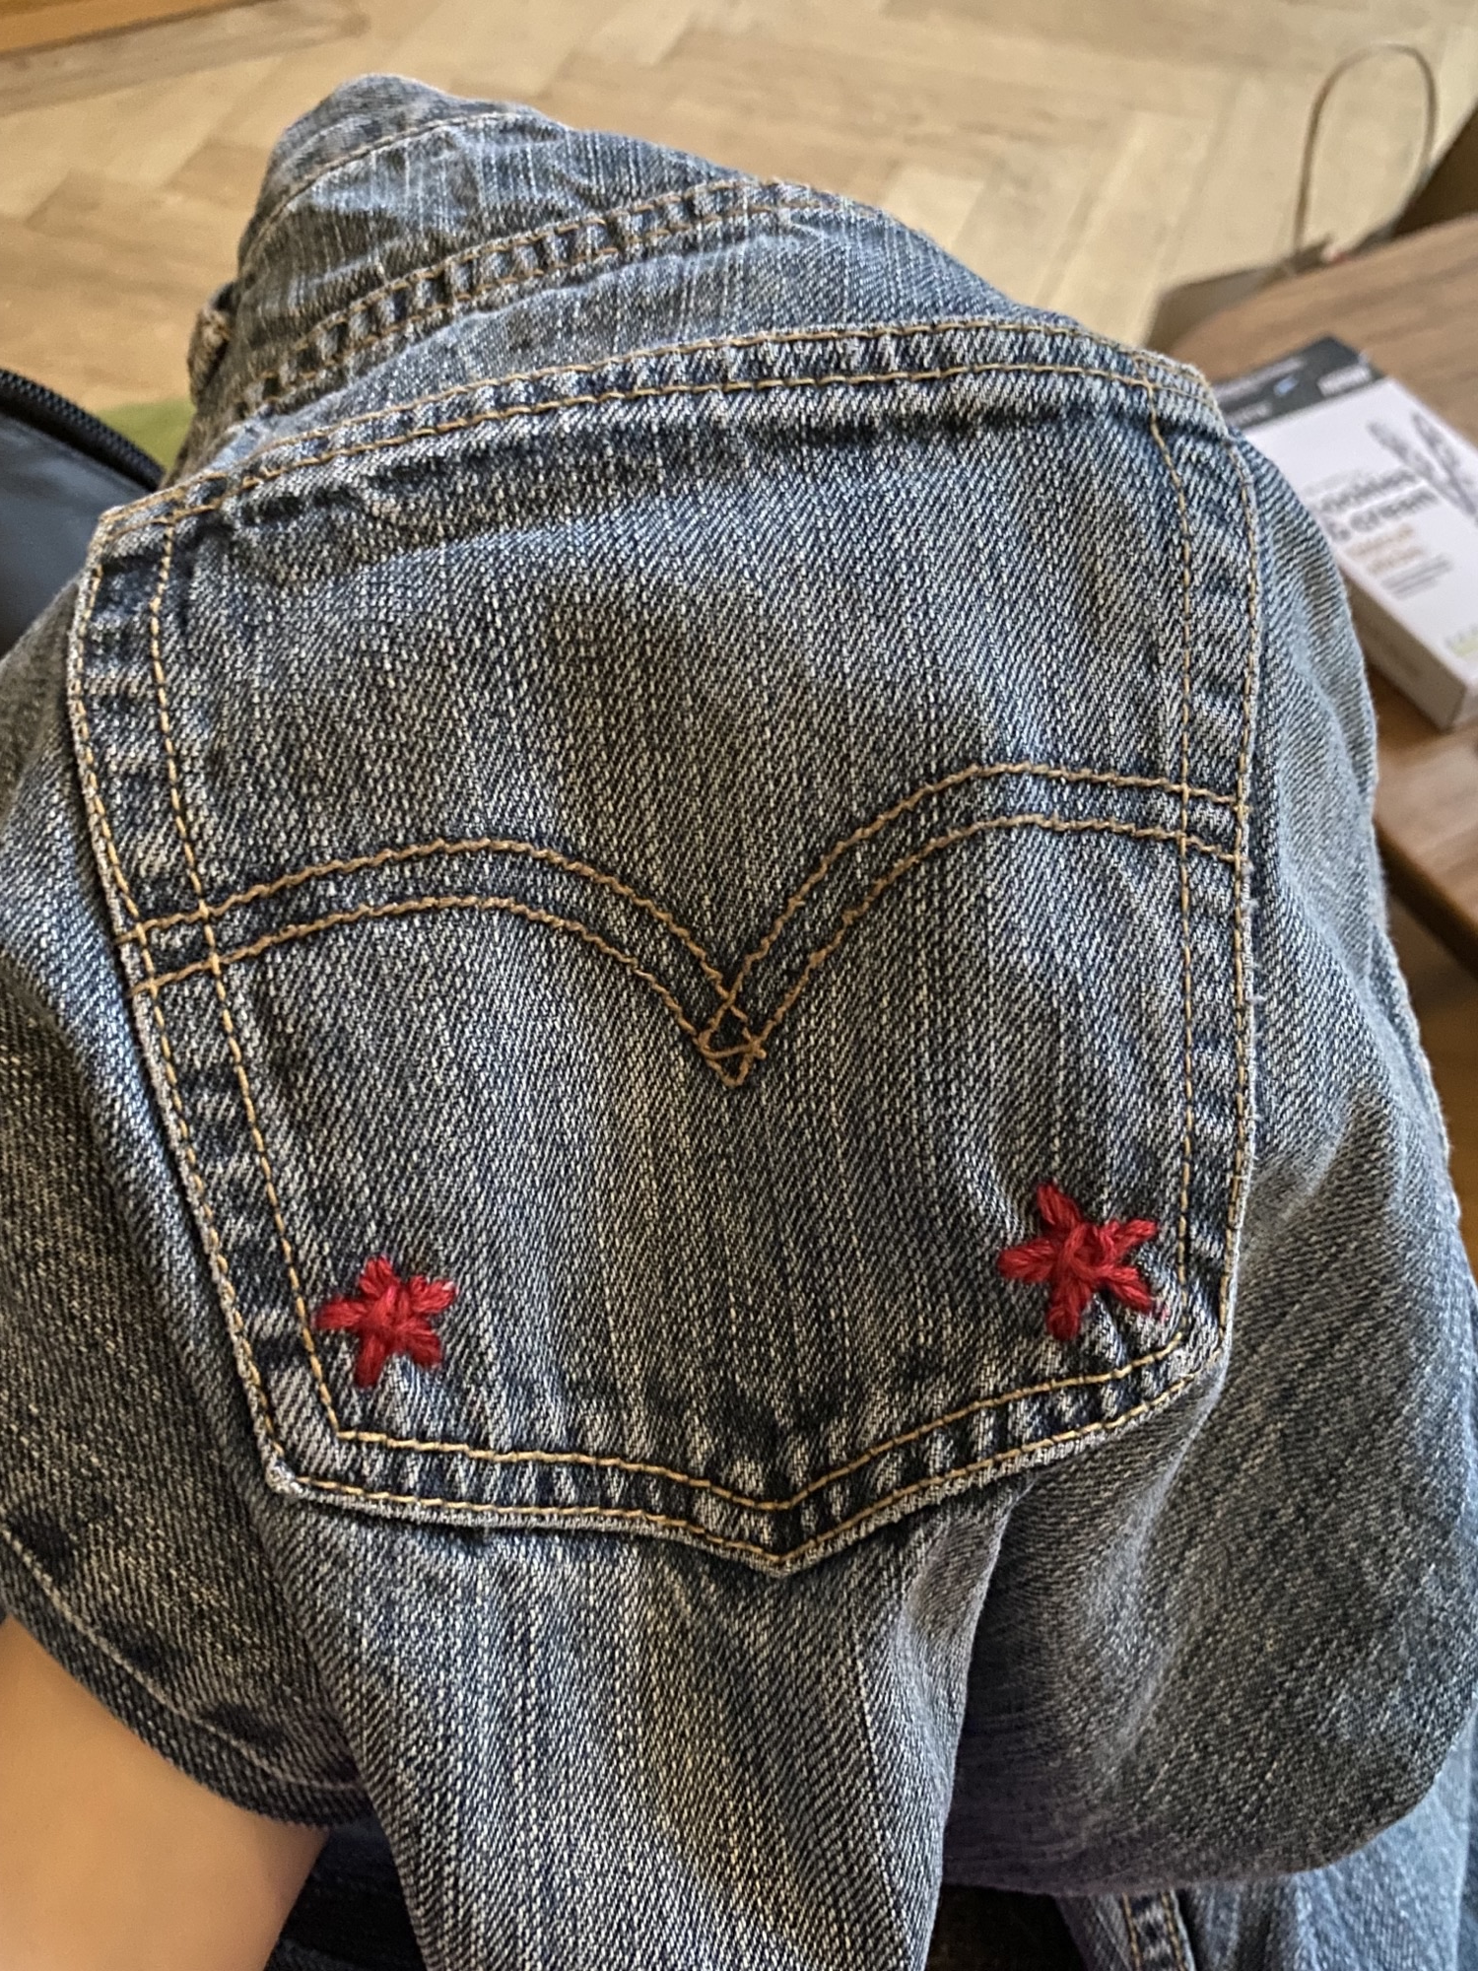
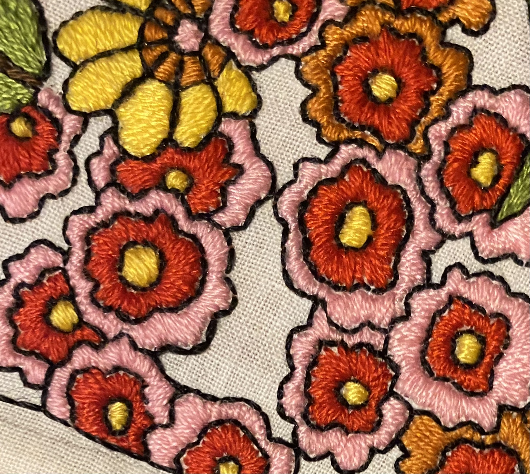
Resources
Glue
Beads
Fabric pens
Chairs
Tables
Needles
Thread
How-to​ Organise a Revive Workshop
​
Choose a location​
This has to be a place that everyone in the area knows and is easily accessible. For example, the sports hall. Alternatively, a venue could be booked; this has to be done with enough notice though.​
Look for volunteers
Ask around to find people who can embroider or are keen crafters to help at the event
Spread the word
Start promoting the event through posters, announcements or notices during lessons
Start collecting what will be needed
For example, large quantities of glue and beads. These can be either from donations or school-provided
Set the event up
Set up tables and chairs. In each station, there should be volunteers to help
Enjoy your customisation!
​
Top tips
Play an embroidery tutorial on a screen or clearly display steps (so less help is needed)
Let different year groups go in at different times
Make sure the stations are labelled

Slide 5
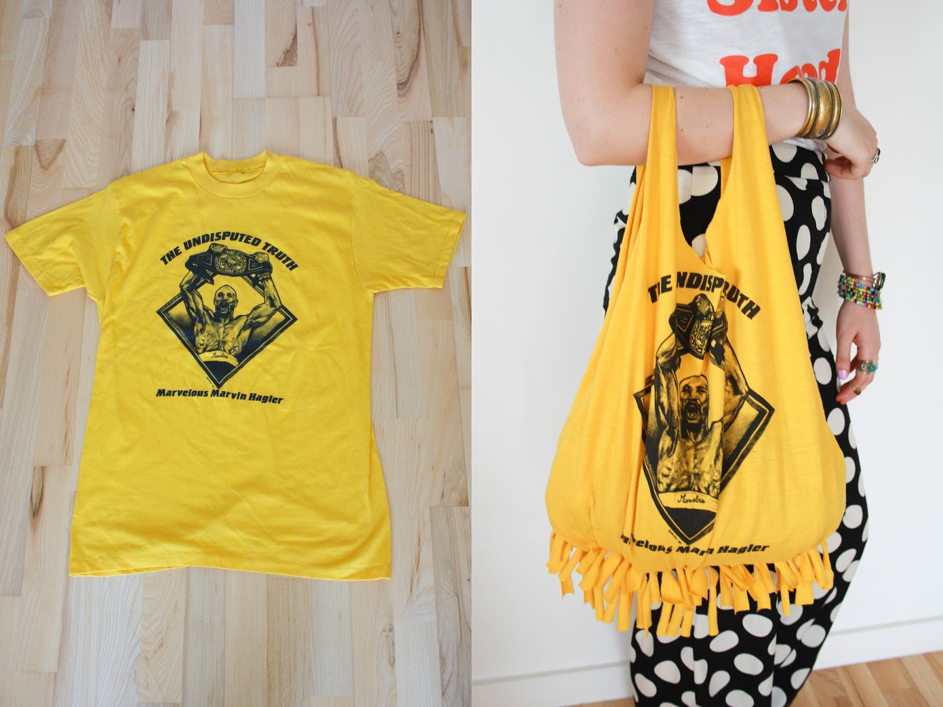
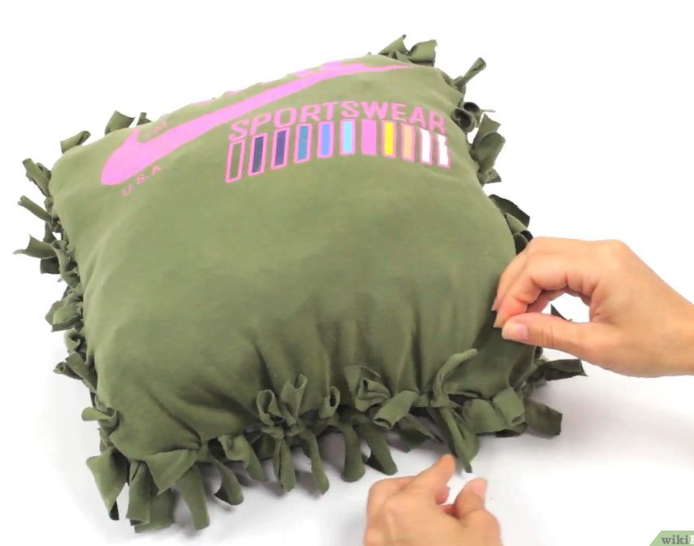
How-to organise a Re-purposing Event
Choose a location
This has to be a well-known location. Preferably, it should be inside so it’s easier to move around as well as to clean afterwards.
Find things to repurpose
For example, books or clothes. These could be brought in by students on the day of or could be collected a couple of days prior to the event. Students may decide to donate their things and repurpose someone else’s or bring them in to repurpose themselves.
Spread the word
This could be done through letters given to students, posters around the school, advertisements on the school’s social media accounts, announcements or notices during lesson.
Set up the stations
In different zones, different items will be repurposed. Make sure they are all clearly labelled so that students can easily decide where to go or what to repurpose.
Enjoy your crafting!
Resources
· Tables
· Chairs
· Tools for Repurposing
· Materials for Repurposing
Top tips
· Make sure the stations are clearly labelled
· If students are to bring in things to donate, make sure to specify they need to be clean and/or have minimal damage
· Have plenty of spare needles, glues and thread

Slide 6
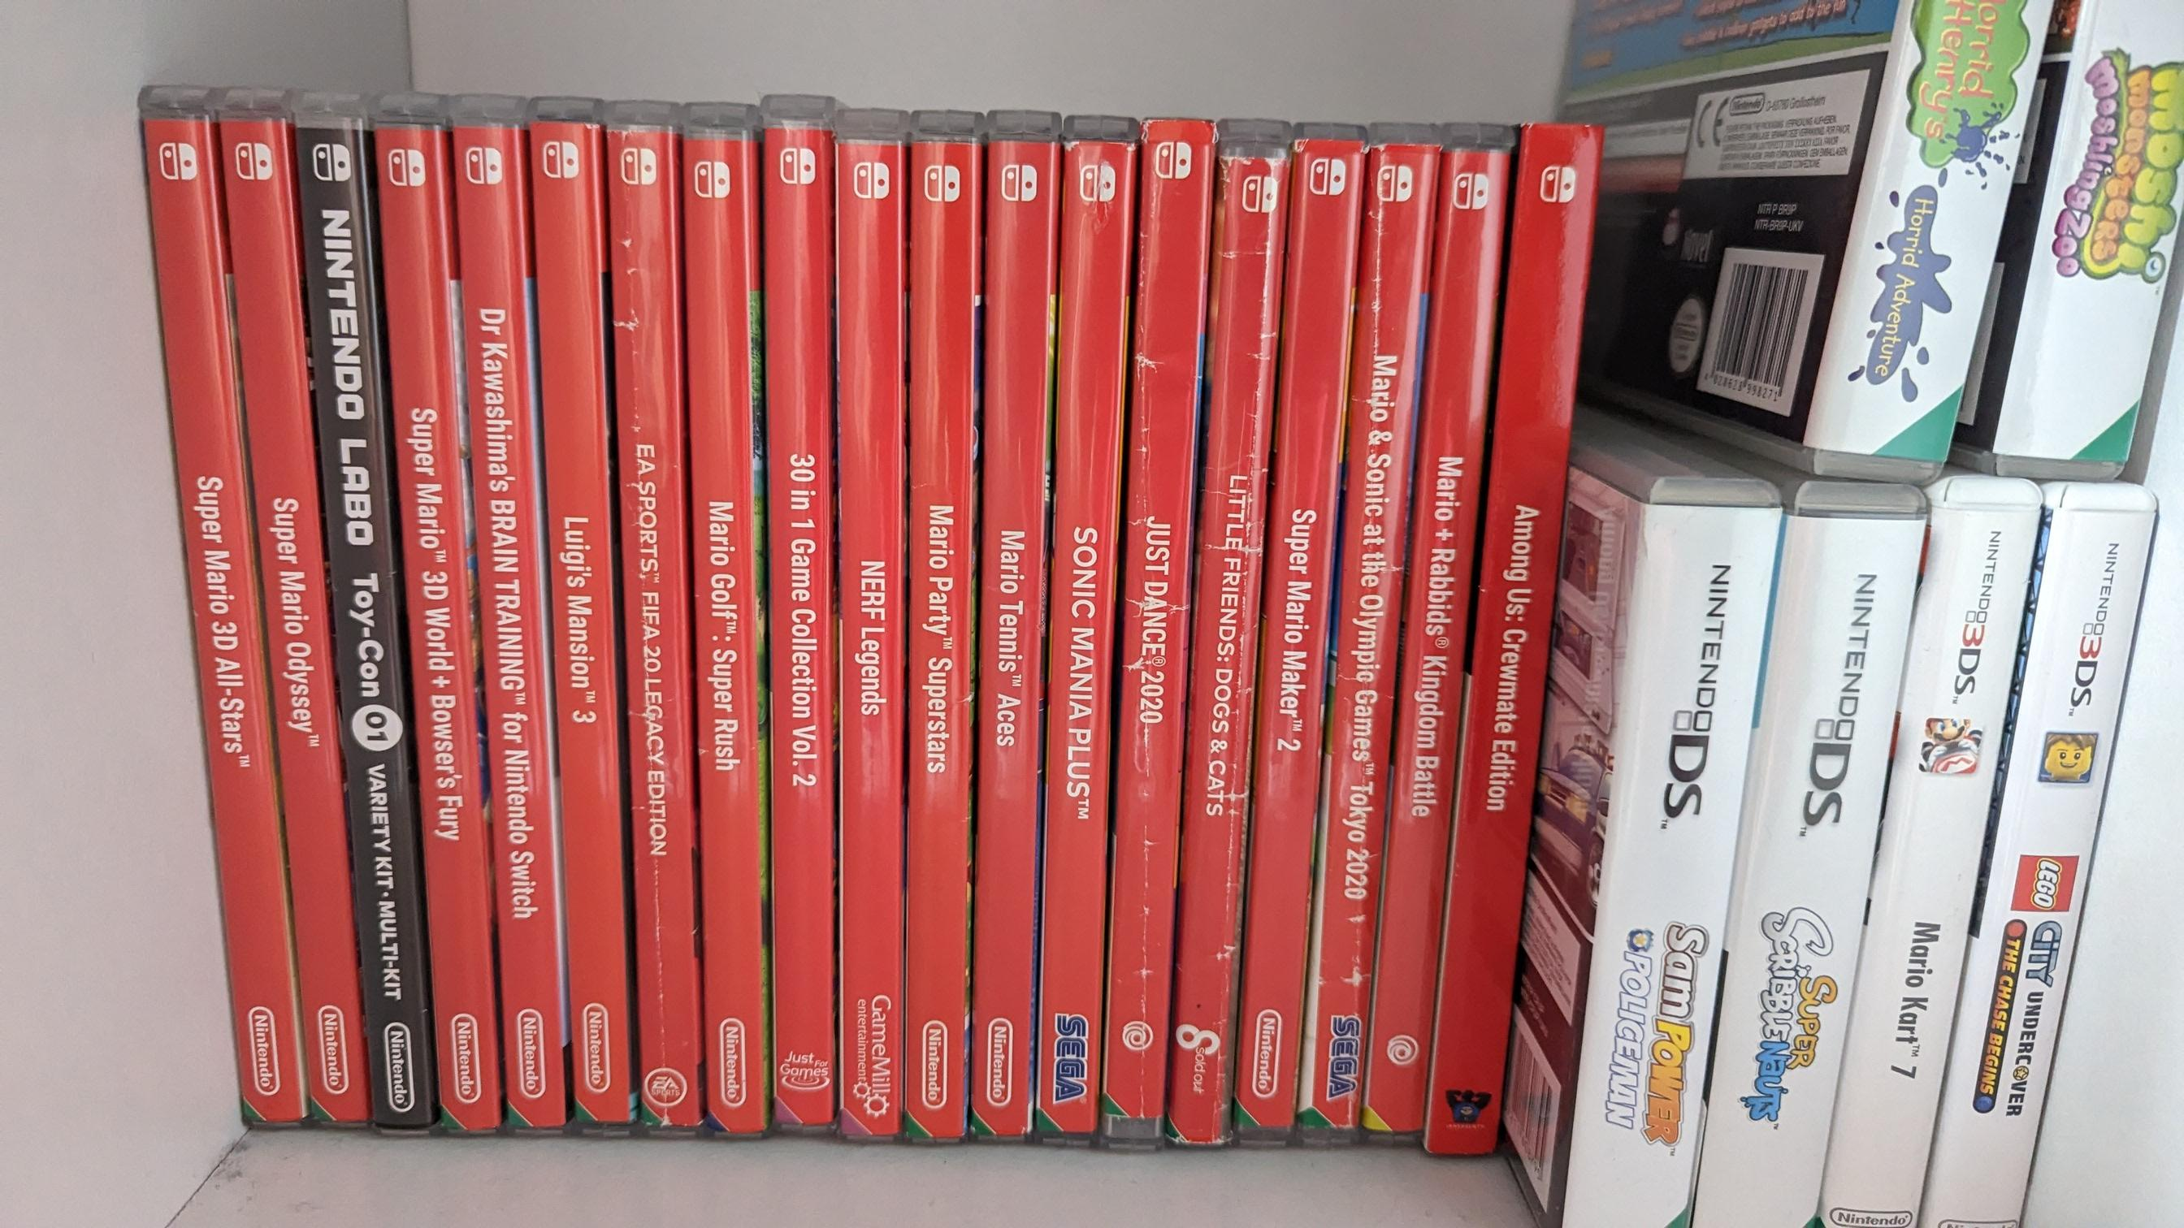
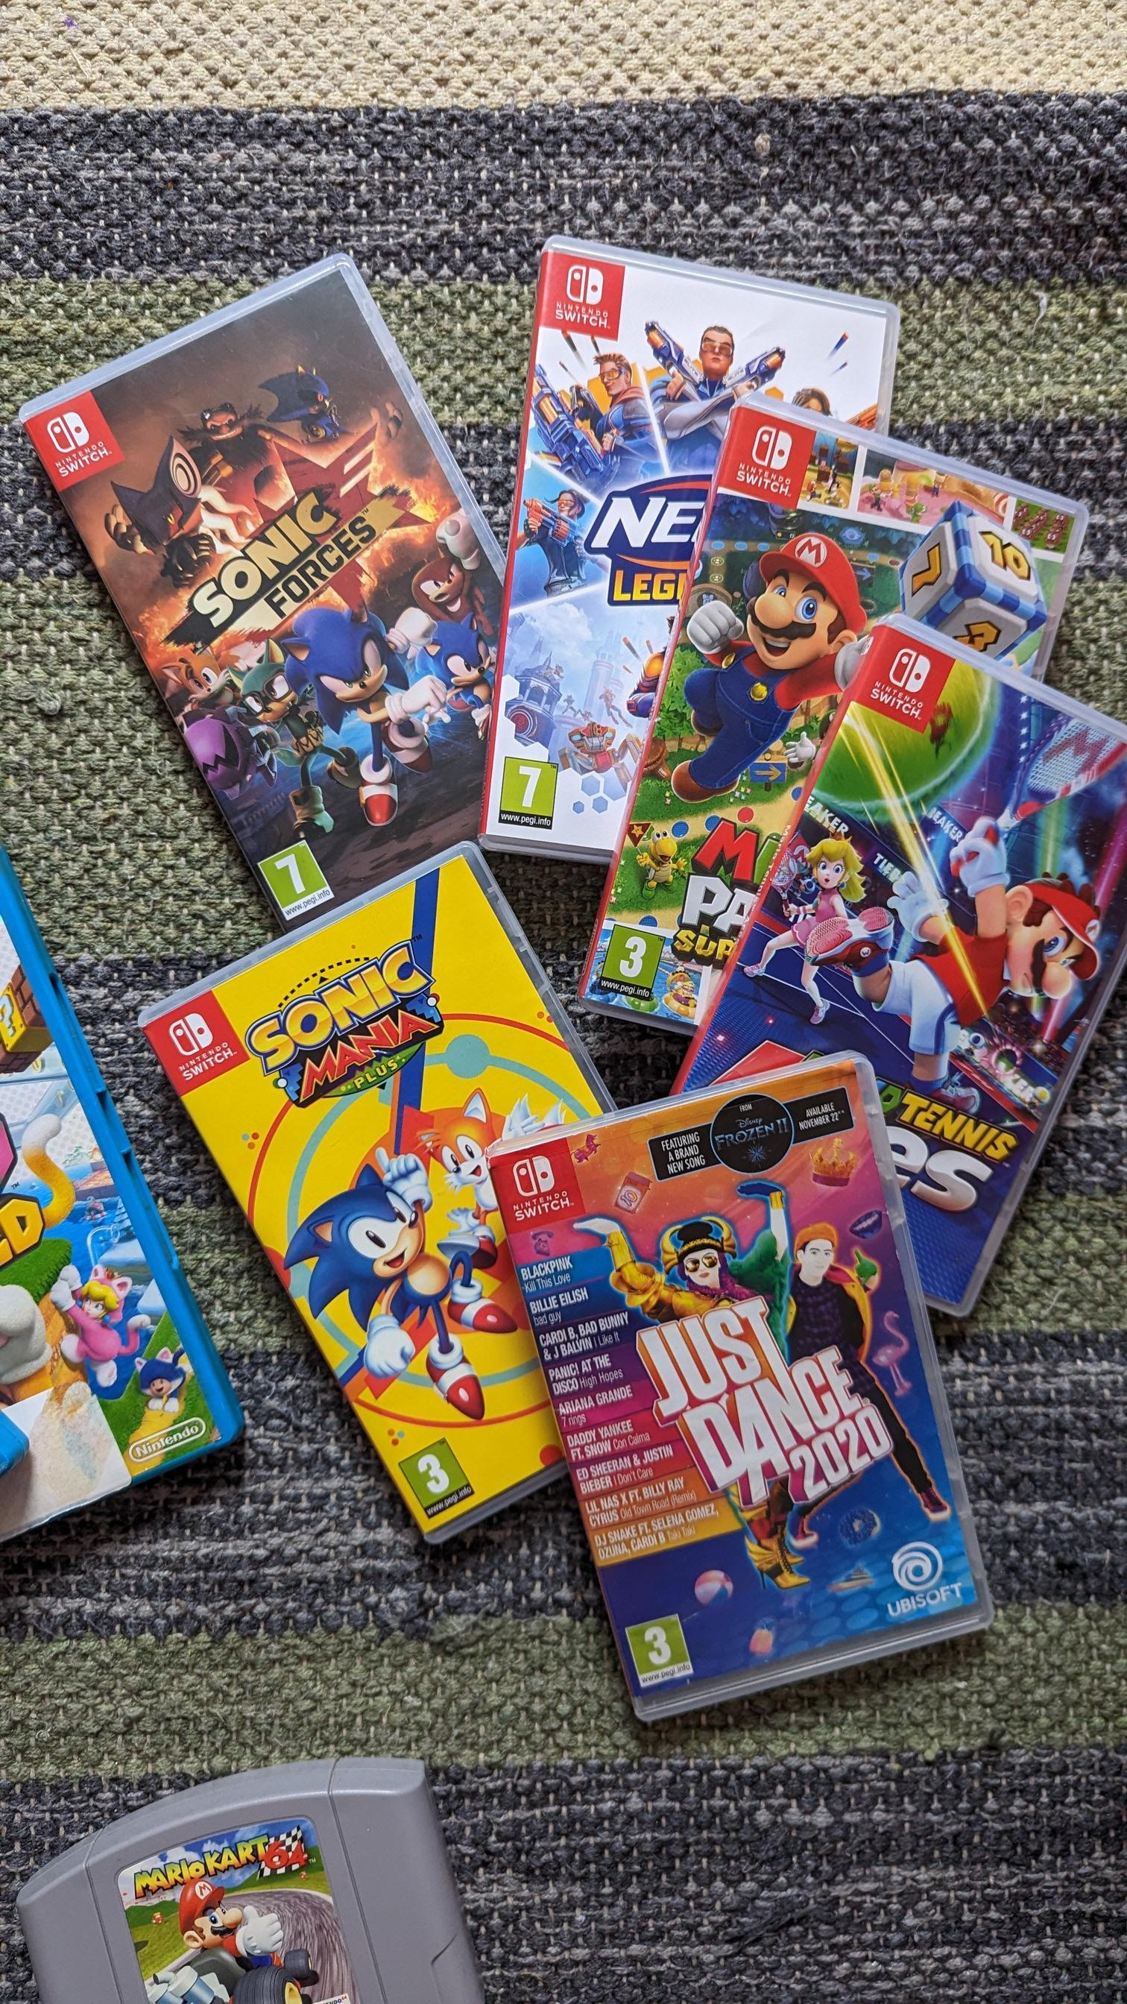
Resources
· Tables
· Games
· Refreshments
· Labels to show the different categories
How-to run a Games Swap
Choose a location
This has to be a place that everyone in the area knows and is easily accessible. For example, the sports hall. Alternatively, a venue could be booked; this has to be done with enough notice though.
Find games
These could be table games or video games. If young children are involved, having toys could be a good idea as well. People can bring games in on the day of or a couple of days before the event, depending on each school.
Spread the word
This could be done through letters given to students, posters around the school, advertisements on the school’s social media accounts, announcements or notices during lesson.
Enjoy your swap!
Top tips
· Divide the area into different parts depending on what type of game visitors can get
· Entry can be either free or through a ticket, although we feel like having a ticket would be better because it ensures that people who’ve donated their games can get something back too

