Slide 1
SSLP Food Bank
An introduction to our community efforts, while keeping the environment in mind.

Slide 2
What do you think the percentage of food poverty in the UK is?
Households reported skipping meals, going hungry or not wasting the whole day in January 2023
Notes:
Encourage audience to discuss with those around them for about 30-45 seconds.
Yeneba

Slide 3
One in five
Households reported skipping meals, going hungry or not eating the whole day in January 2023
Notes:
Emphasise this statistic, and ensure your audience keeps this in mind while you continue your presentation.
Yeneba

Slide 4
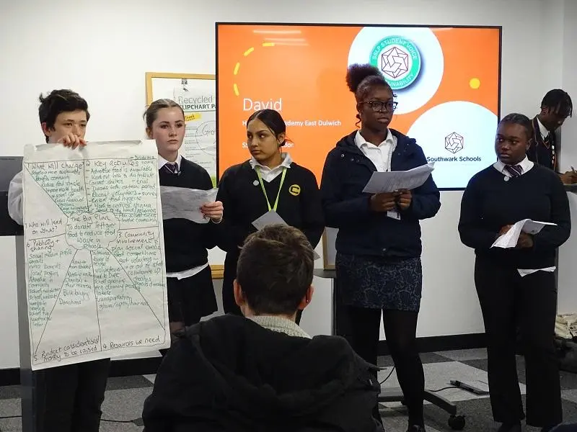
A little about us
The SSLP brings together Partner schools with a common desire to provide both academic and vocational opportunities for students, where we learn with and from our peers. This year, the theme for Student voice is Sustainability
Notes:
You should talk briefly about Student Voice, specifically introducing members in your school. Do mention that this year the theme is Sustainability.
Fetas

Slide 5
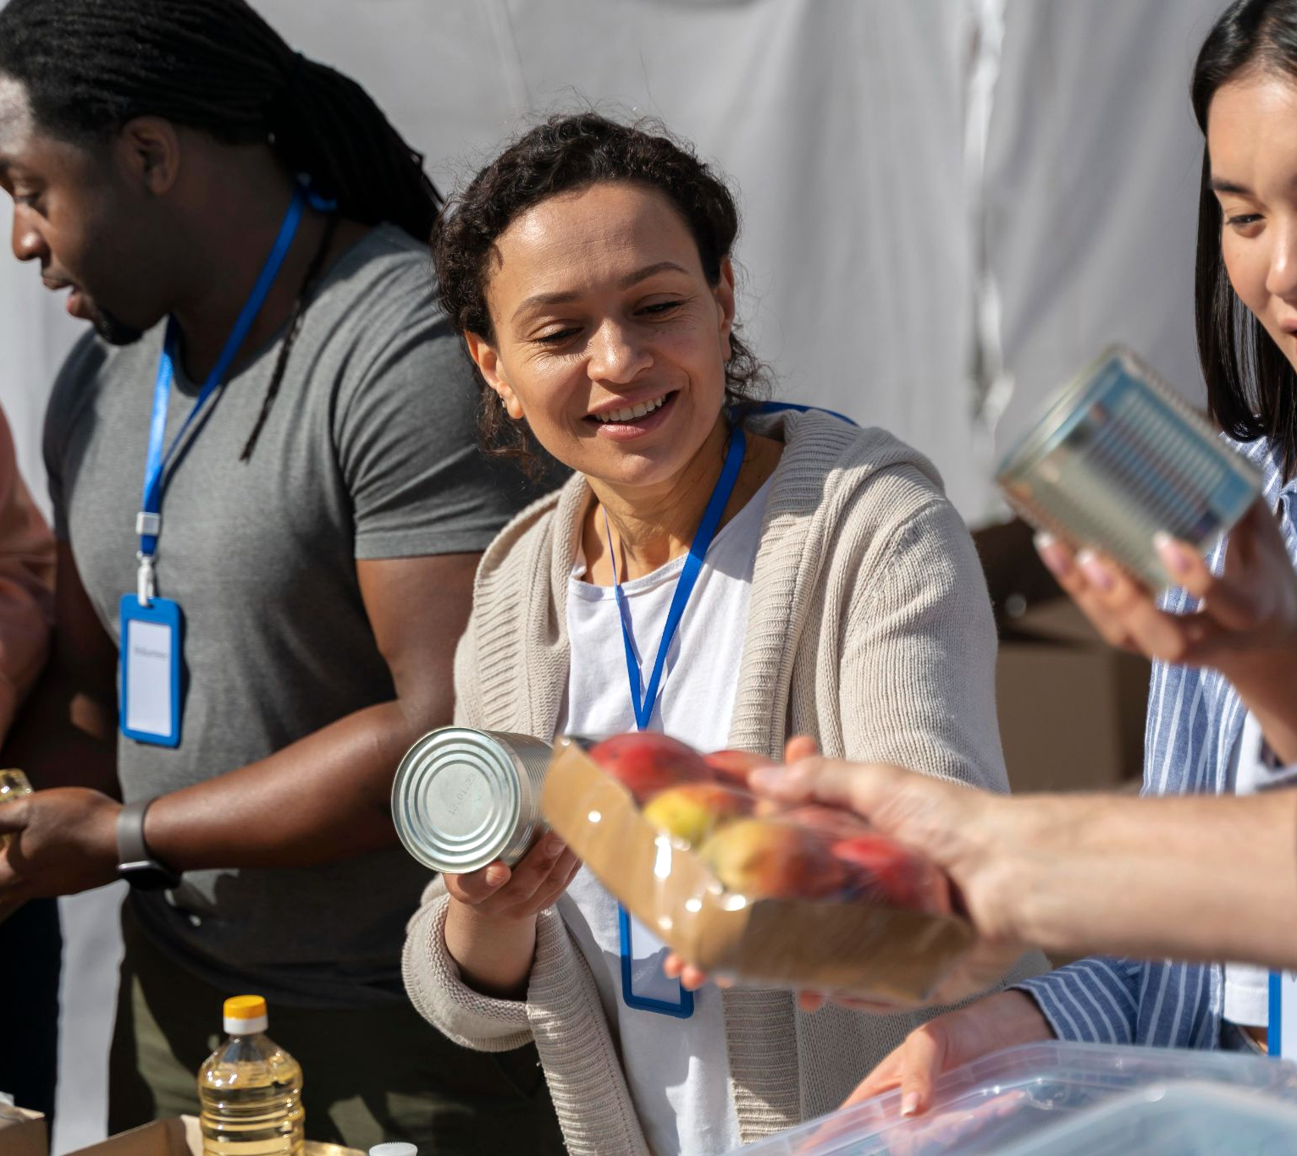
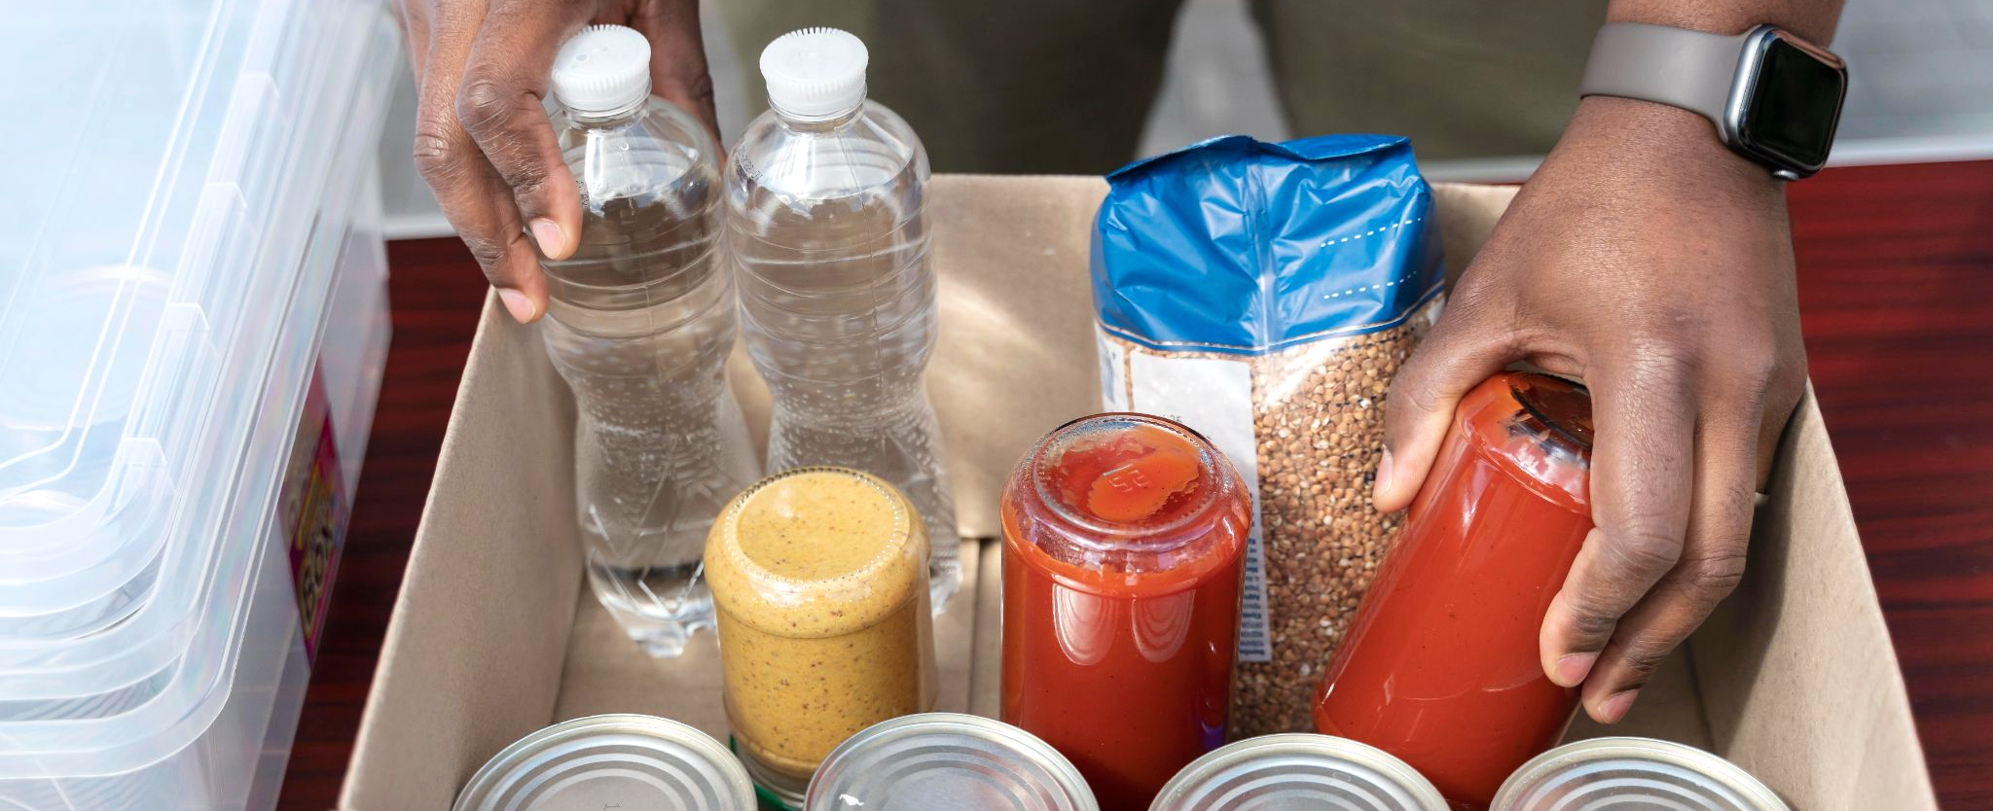
01.
How did it start?

Slide 6
A chain line of events
24 Nov
Thursdays
Today
24 May
Student Conference
Project meetings with peers
Presentation day
Project Celebration Event
1
2
3
4
Notes:
Give a brief explanation of our initial conference. You could talk about how we were split into 4 groups of 3/4 schools, and how our group has decided to focus on food wastage.
You can proceed to talk about our Thursday meetings, where we would collaborate, and keep each other up to speed on any progress.
Explaining that this presentation is for raising awareness of the harms of food wastage, and how we can help reduce this by redistributing to those in need. This will summarise the reasoning behind the presentation, so keep this short and simple.
End off by mentioning our Celebration event, where we promote our ideas to the entire Student Voice, where we attempt to win majority favour.
Sahl

Slide 7
Saving our environment
20%
75%
Yet…
Of population in food poverty (13 million)
Of food waste is generated by households
Notes:
Express how dire the food poverty crisis is, by explaining that 75% of food waste is from us as a society, yet 20% of society struggles to provide food to the table sufficiently.
William

Slide 8
Food wastage hurts our environment
Emissions | Depletion | Bio-loss | Degradation
Food sent to landfills decomposes and releases methane, contributing to global warming. | Wasted food leads to the waste of valuable resources (water, energy, land) | Land cleared for agriculture for lost food. Species lose habitats and become endangered or even extinct | Wasted food breaks down in landfill soil and releases harmful chemicals, contaminating soil. This can ruin soil quality for future crops.
Notes:
These are ways wastage impacts our world.
Briefly go through each of these four points. Ensure this doesn’t take longer than a minute – while facts are important, spending too much time on environmental facts will stray the focus on food poverty, which affects many in our communities.
Most people are somewhat aware of the impact of food waste, so do not worry about taking time on this slide.
William

Slide 9
How it’ll work
Step 1
Step 3
Step 5
Finalise donation point
All items collected by us
Students rewarded for each item donated
Step 2
Step 4
Students will bring in unwanted food
Food redistributed to retail donation points (Sainsbury’s, Tesco, etc.)
Notes:
This is a rough method where a food bank system can be implemented.
1. Schools can facilitate a drop-off point where students can simply donate any foods that are suitable.
2. We will use a poster to explain what type of foods we are looking for, so as not to encourage unnecessary items being brought.
3. Once students have finished donating, this can be collected by SSLP representatives.
4. Local retailers such as Sainsbury’s and Lidl have donation drop-offs, and SSLP members can visit one and simply bring student donations there.
5. An incentive can be implemented, each school can implement their own effective rewards system, to promote regular donation. It is essential these rewards systems are always maintained, to not put-off students from donating.
Sahl

Slide 10
Rumi– Persian Scholar
Why are we doing this?
“The sounds made by the spoons and pots of the wealthy, heard by the poor and hungry.”
His response after being asked about what music is forbidden in Islam
Notes:
This is a quote from Persian Scholar, Rumi. He is well-known for his poetry, and many of his quoted words.
The quote suggests that the worst thing to be able to hear is the sound of clattering cutlery made by the wealthy as they feast, while the poor can only hear the joy of eating well.
Link this quote to how the less fortunate wish for the things we take for granted, and food is one of these things.
Sahl

Slide 11
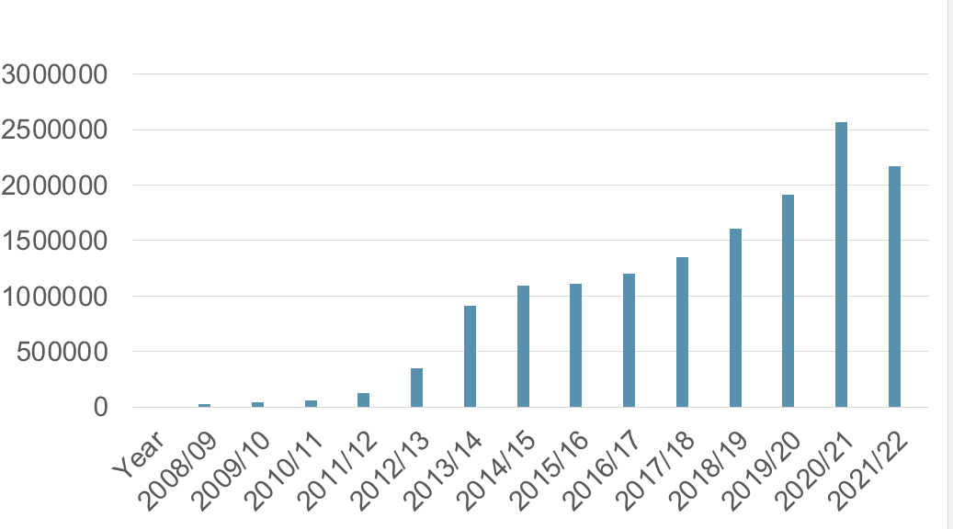
Reliance on food banks*
Number of people receiving three days’ worth of emergency food by the Trussell Trust food banks in the UK (2008-22)
Notes:
Highlight the massive rise of emergency use of food banks. Use this graph to explain how essential food banks are, and that their implementation in communities is vital.
Shania and Gibson

Slide 12
“Poverty and material and moral misery are everywhere. There is little to cheer us. It’s not our fault: unthinking rulers, ignorant of the way of the world, have run this country for years, not to say centuries, and reduced a paradise to this sorry state.” Mustafa Kemal Atatürk – Founder of Republic of Turkey
Notes:
This quote can apply to the state of the UK today… corrupt politicians sticking to their backward, selfish ways at the cost of the suffering of the state.
While this suffering hasn’t been caused by our own actions, we can better our situation by helping each other during these difficult times, while also playing our part in saving the environment.
Gibson and Shania

Slide 13
To wrap it up…
We ask for a simple act of kindness, and this will go a long way:
Be considerate of how much food you buy - is it really necessary?
Donate any food that can be better used elsewhere
Check in on your neighbours… do not let them suffer with the sound of your cutlery clattering! See if they could use some help.
Notes:
Simply repeat what this slide says.
Aliyat

Slide 14
Thank you!
Do you have any questions?
Notes:
Each school can choose who to direct any questions to. Simply edit the contact details of this slide to suit your individual school.
Well done you can now rest!

