Slide 1
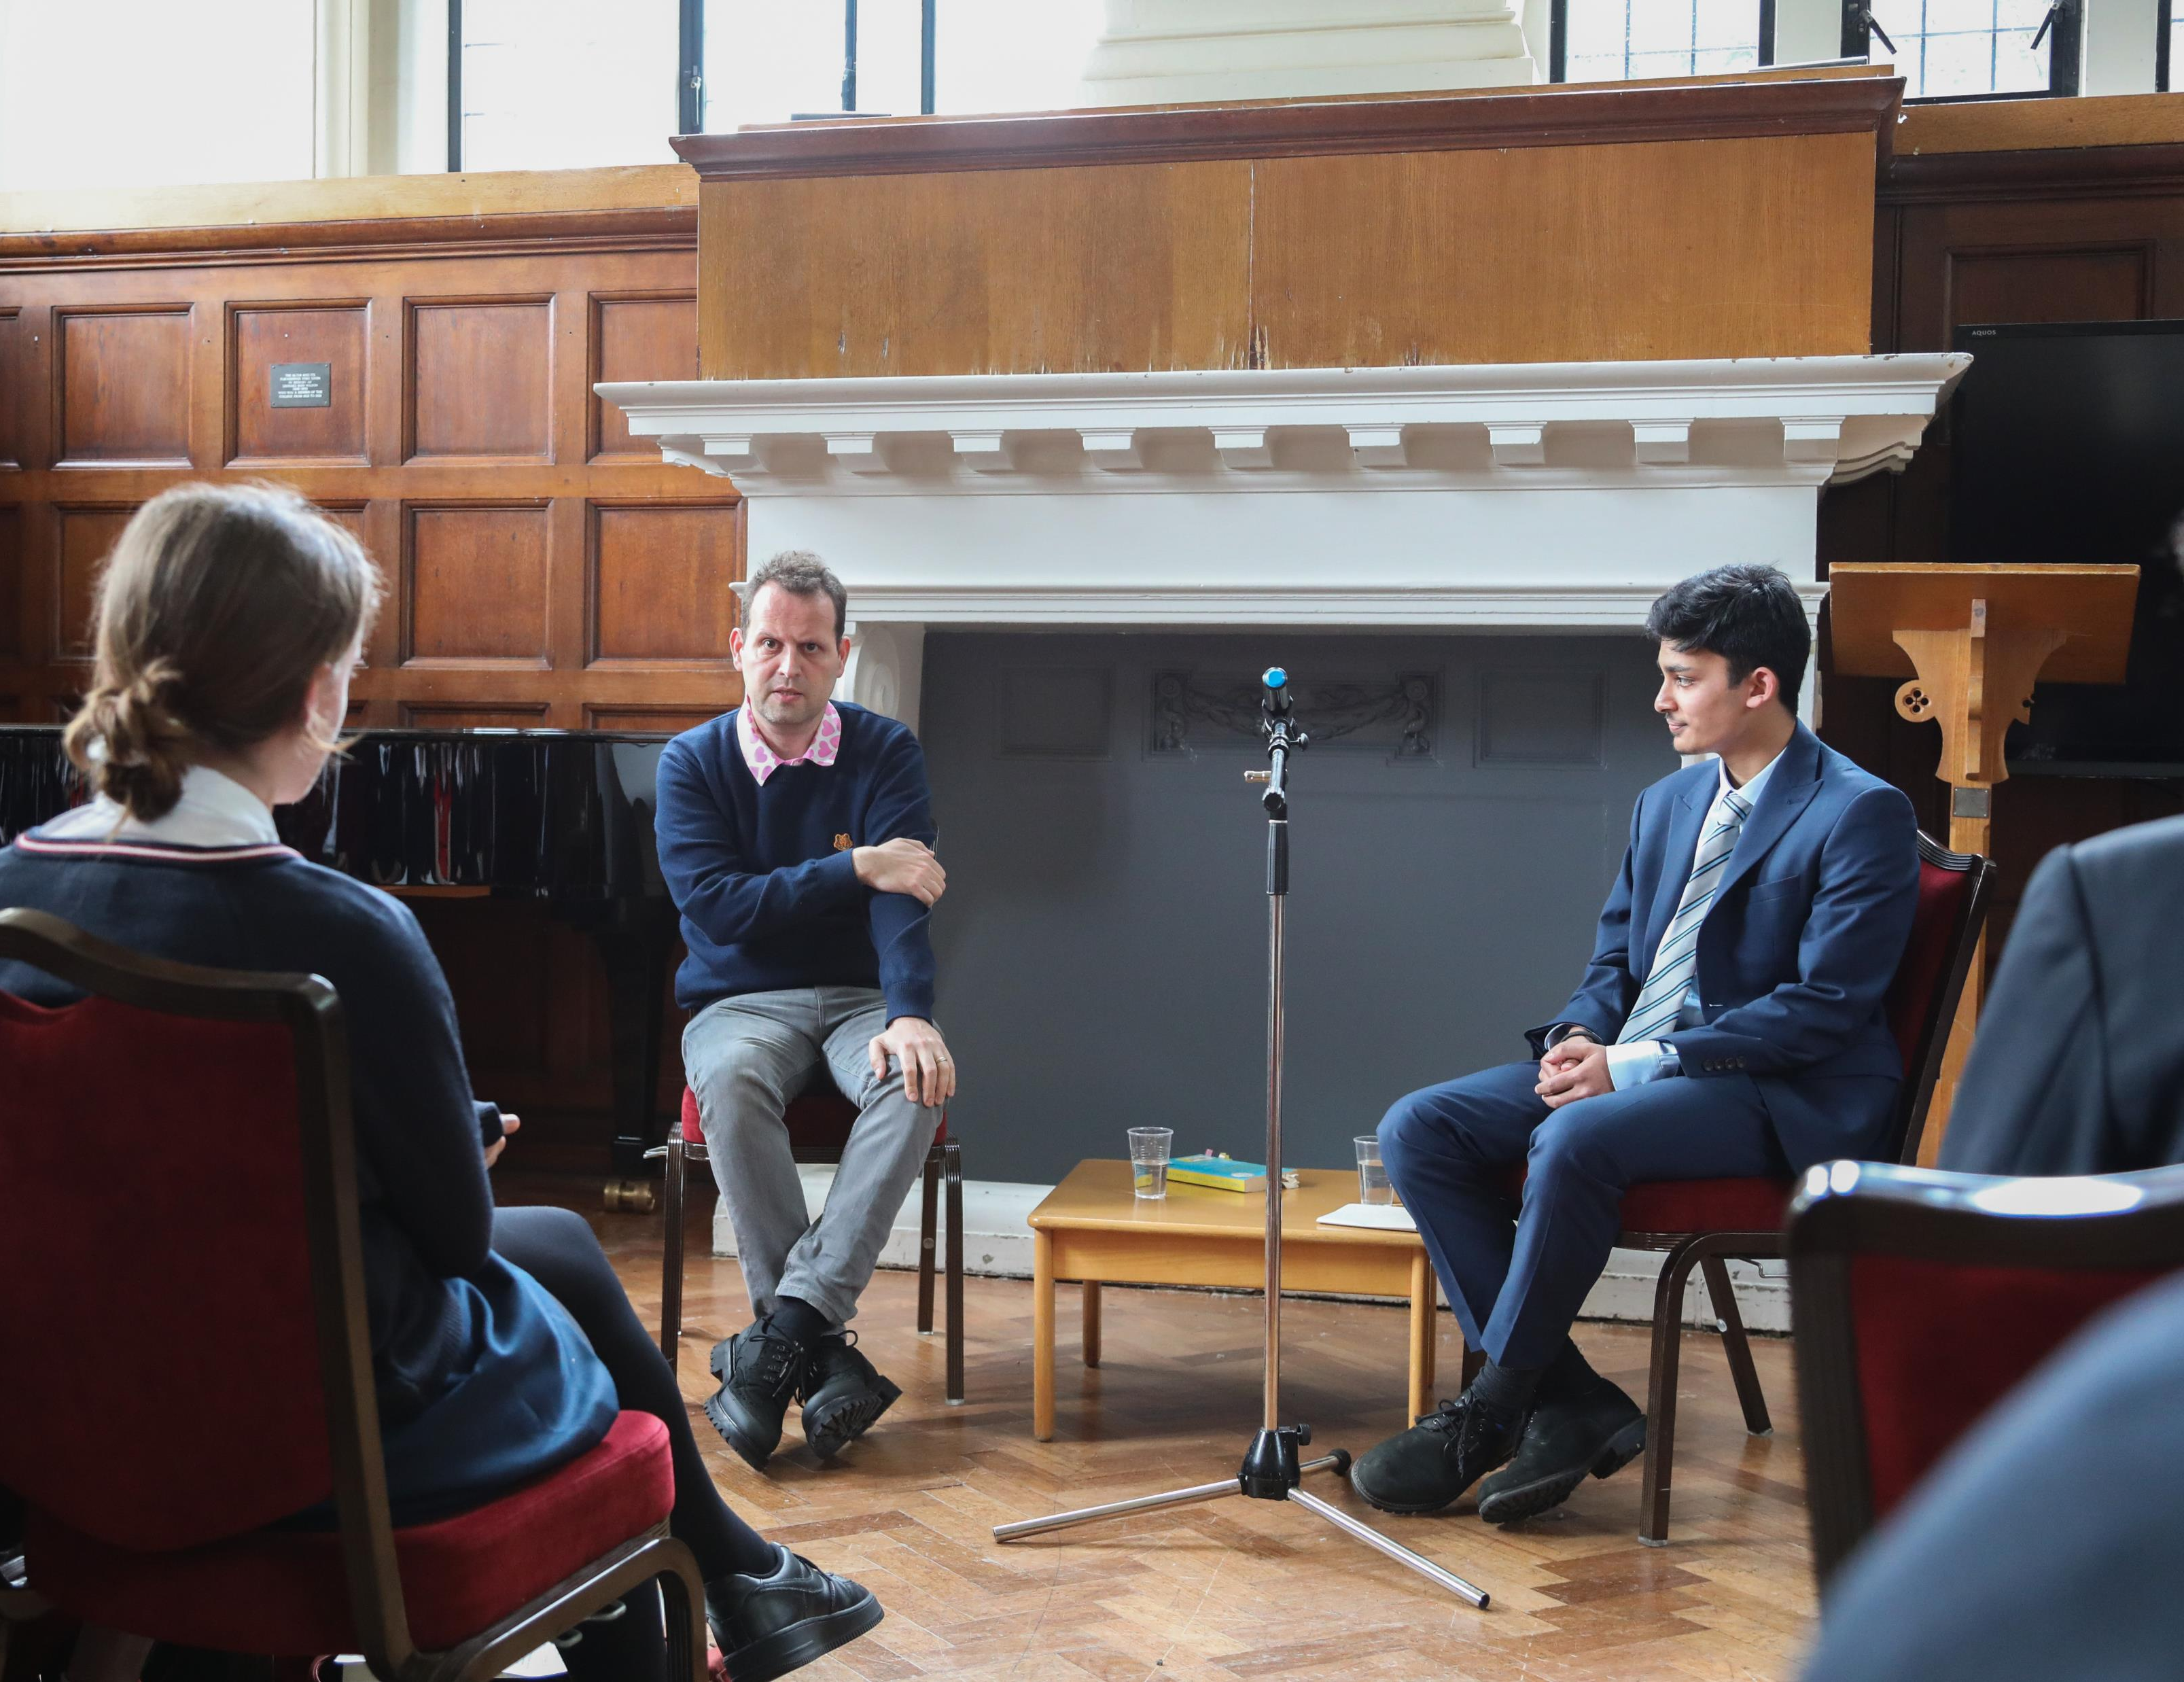
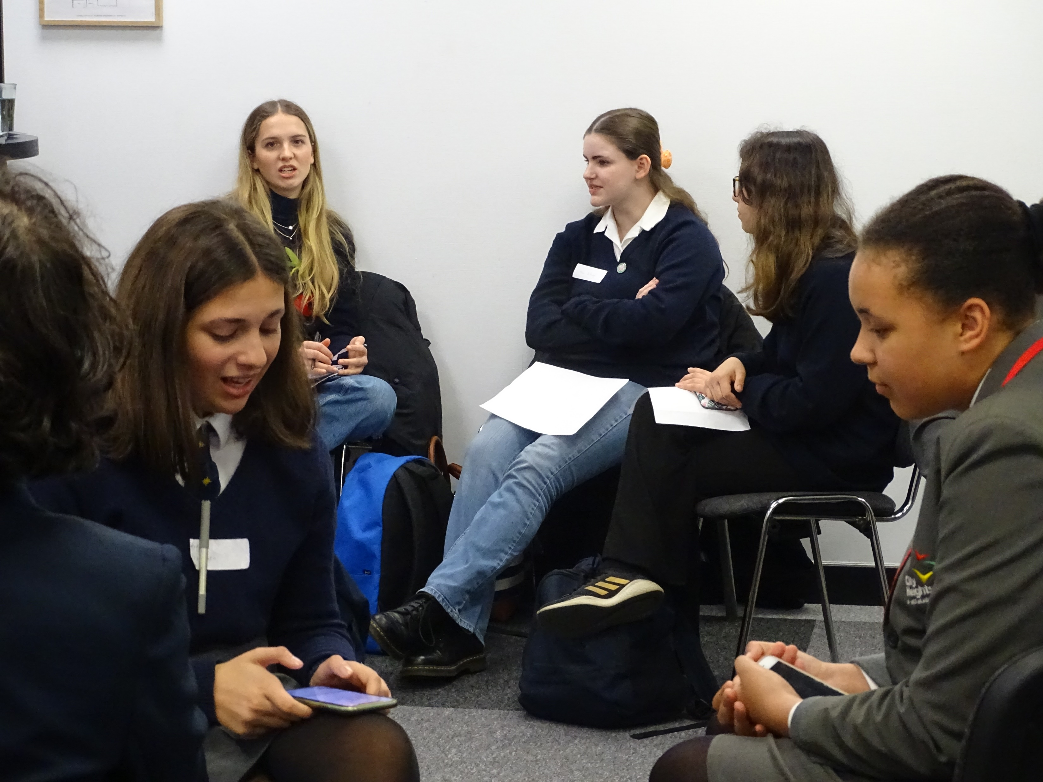
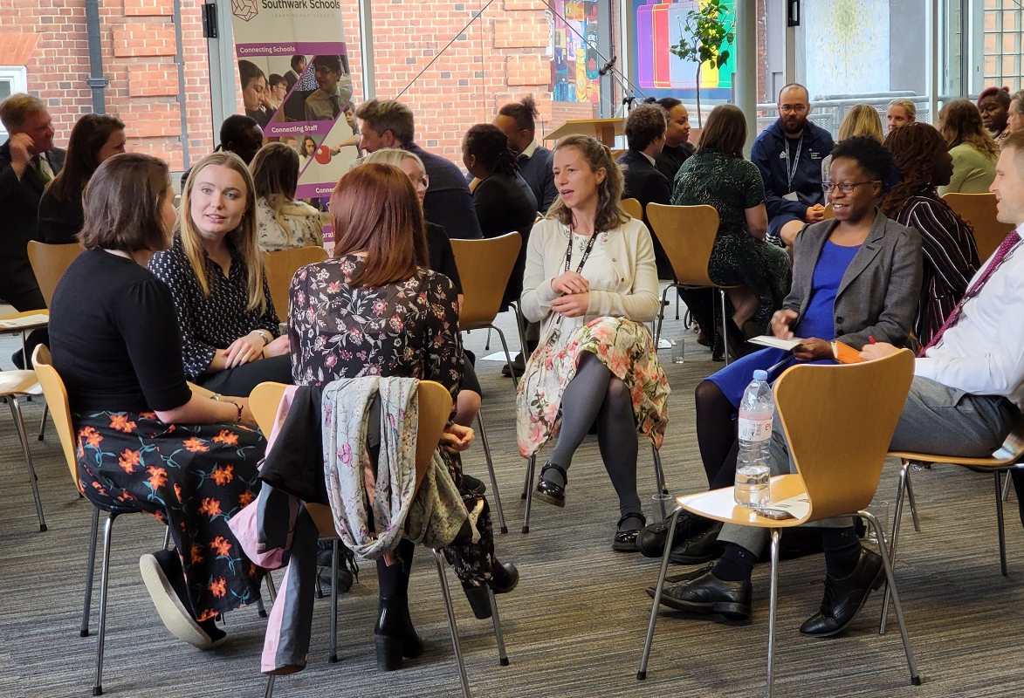
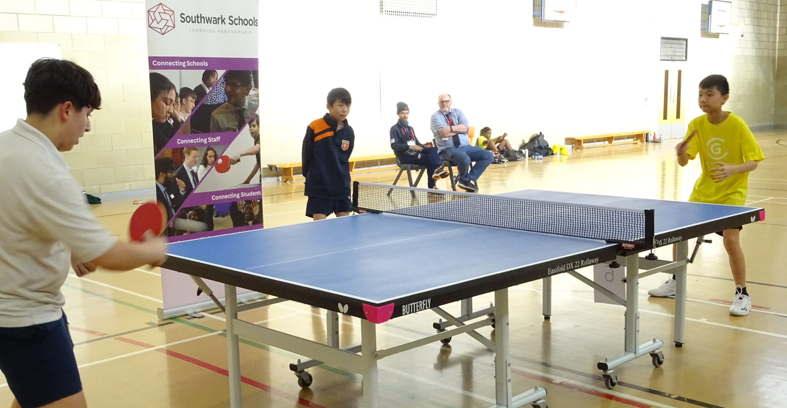
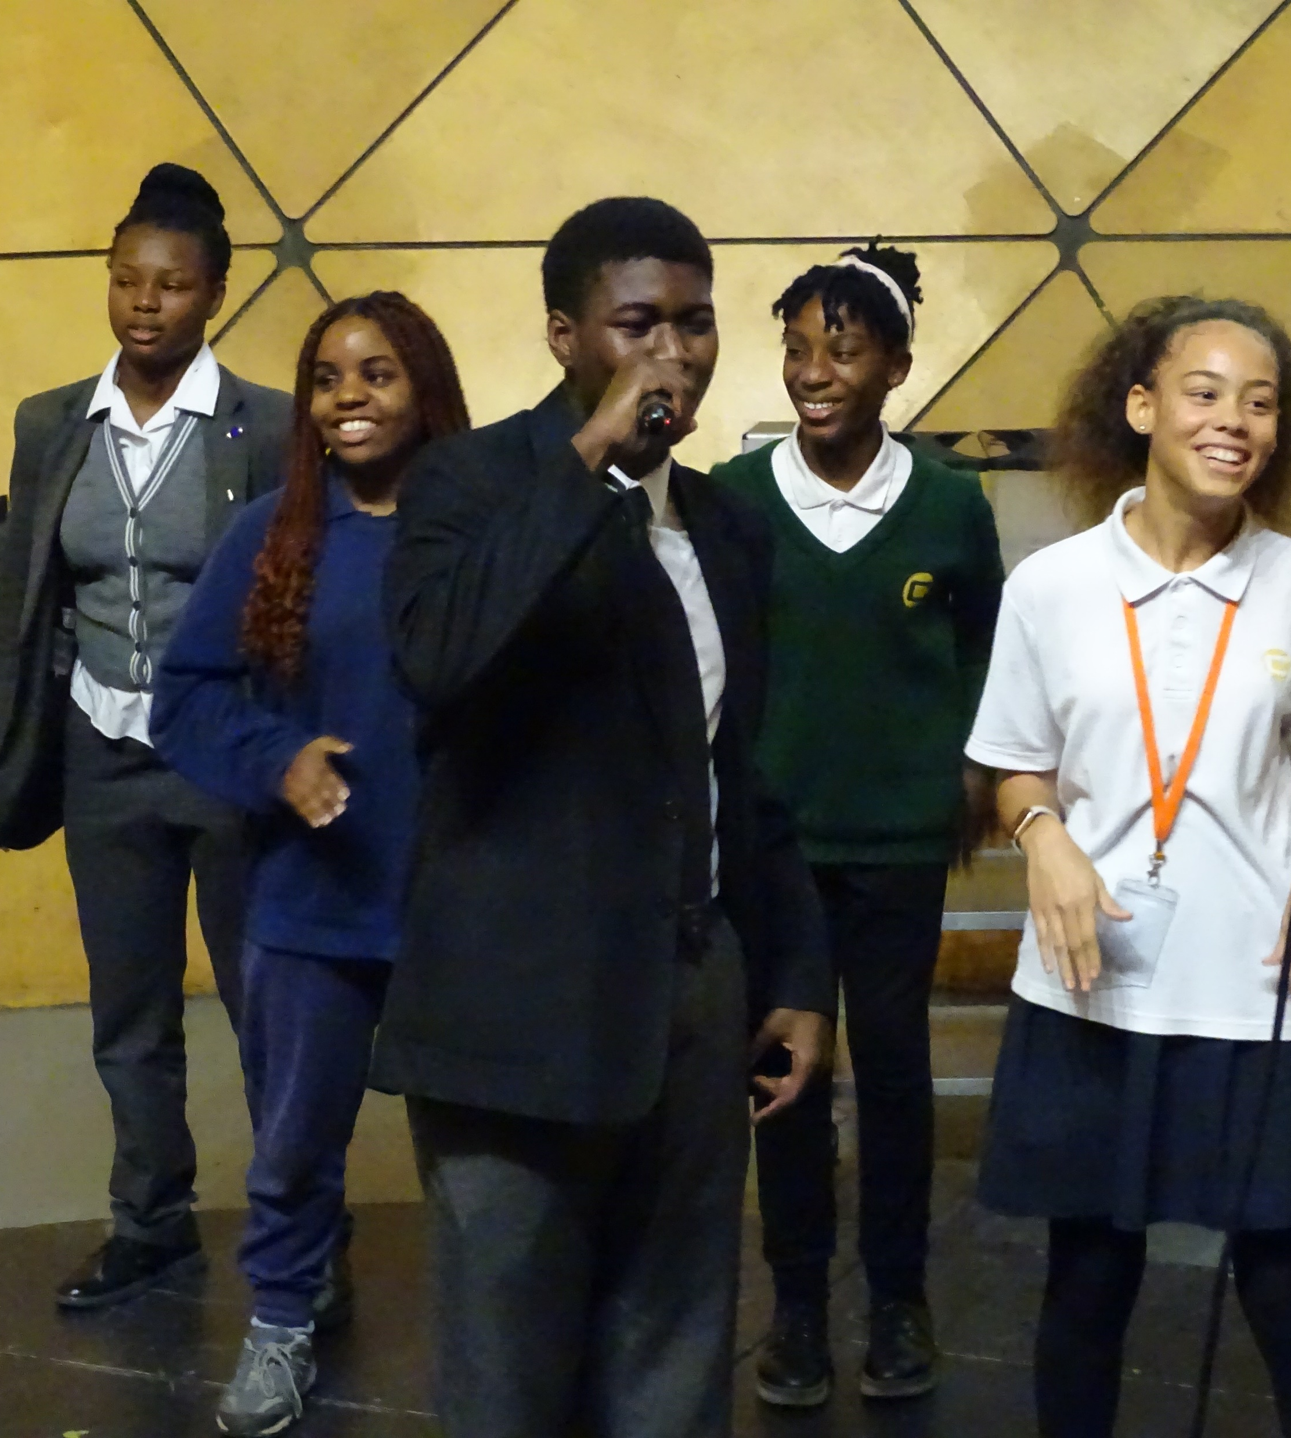
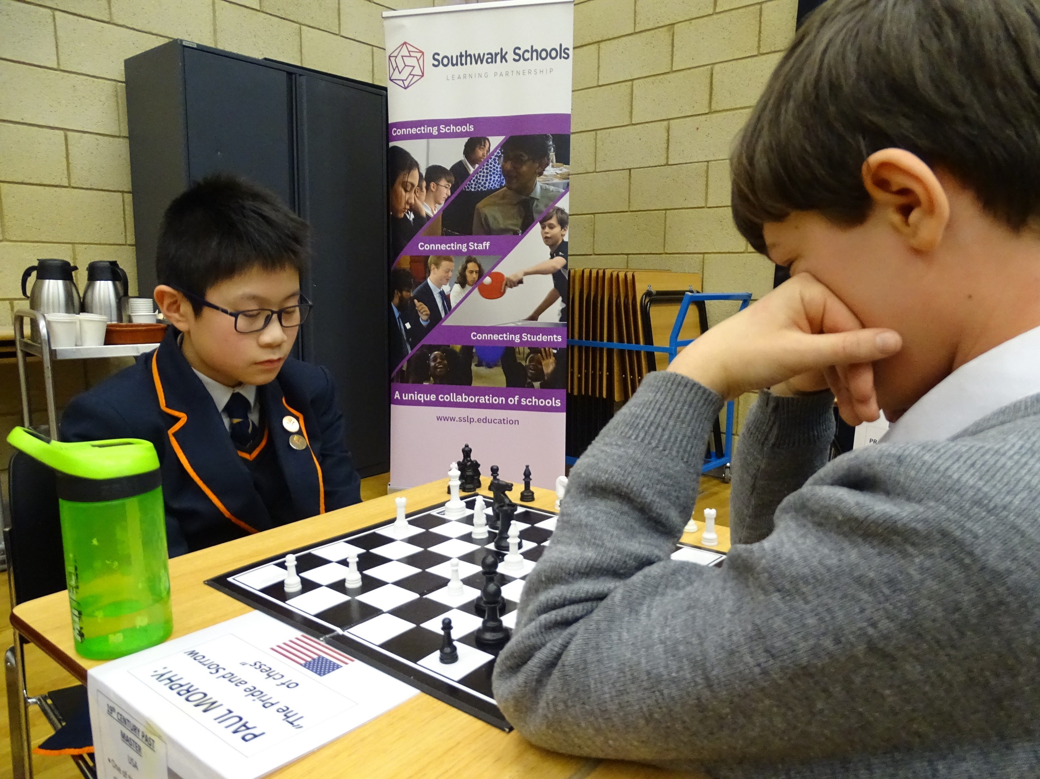
SSLP Launch 2023

Slide 2
Welcome to Kingsdale Foundation School
Daniel Harding

Slide 3
Joe Spence
SSLP Co-Director & Master of Dulwich College
SSLP Activities
72 Exclusive Events
23 Connecting Schools
13 Connecting Staff
36 Connecting Students
9 Meetings
17 Requests for support

Slide 4
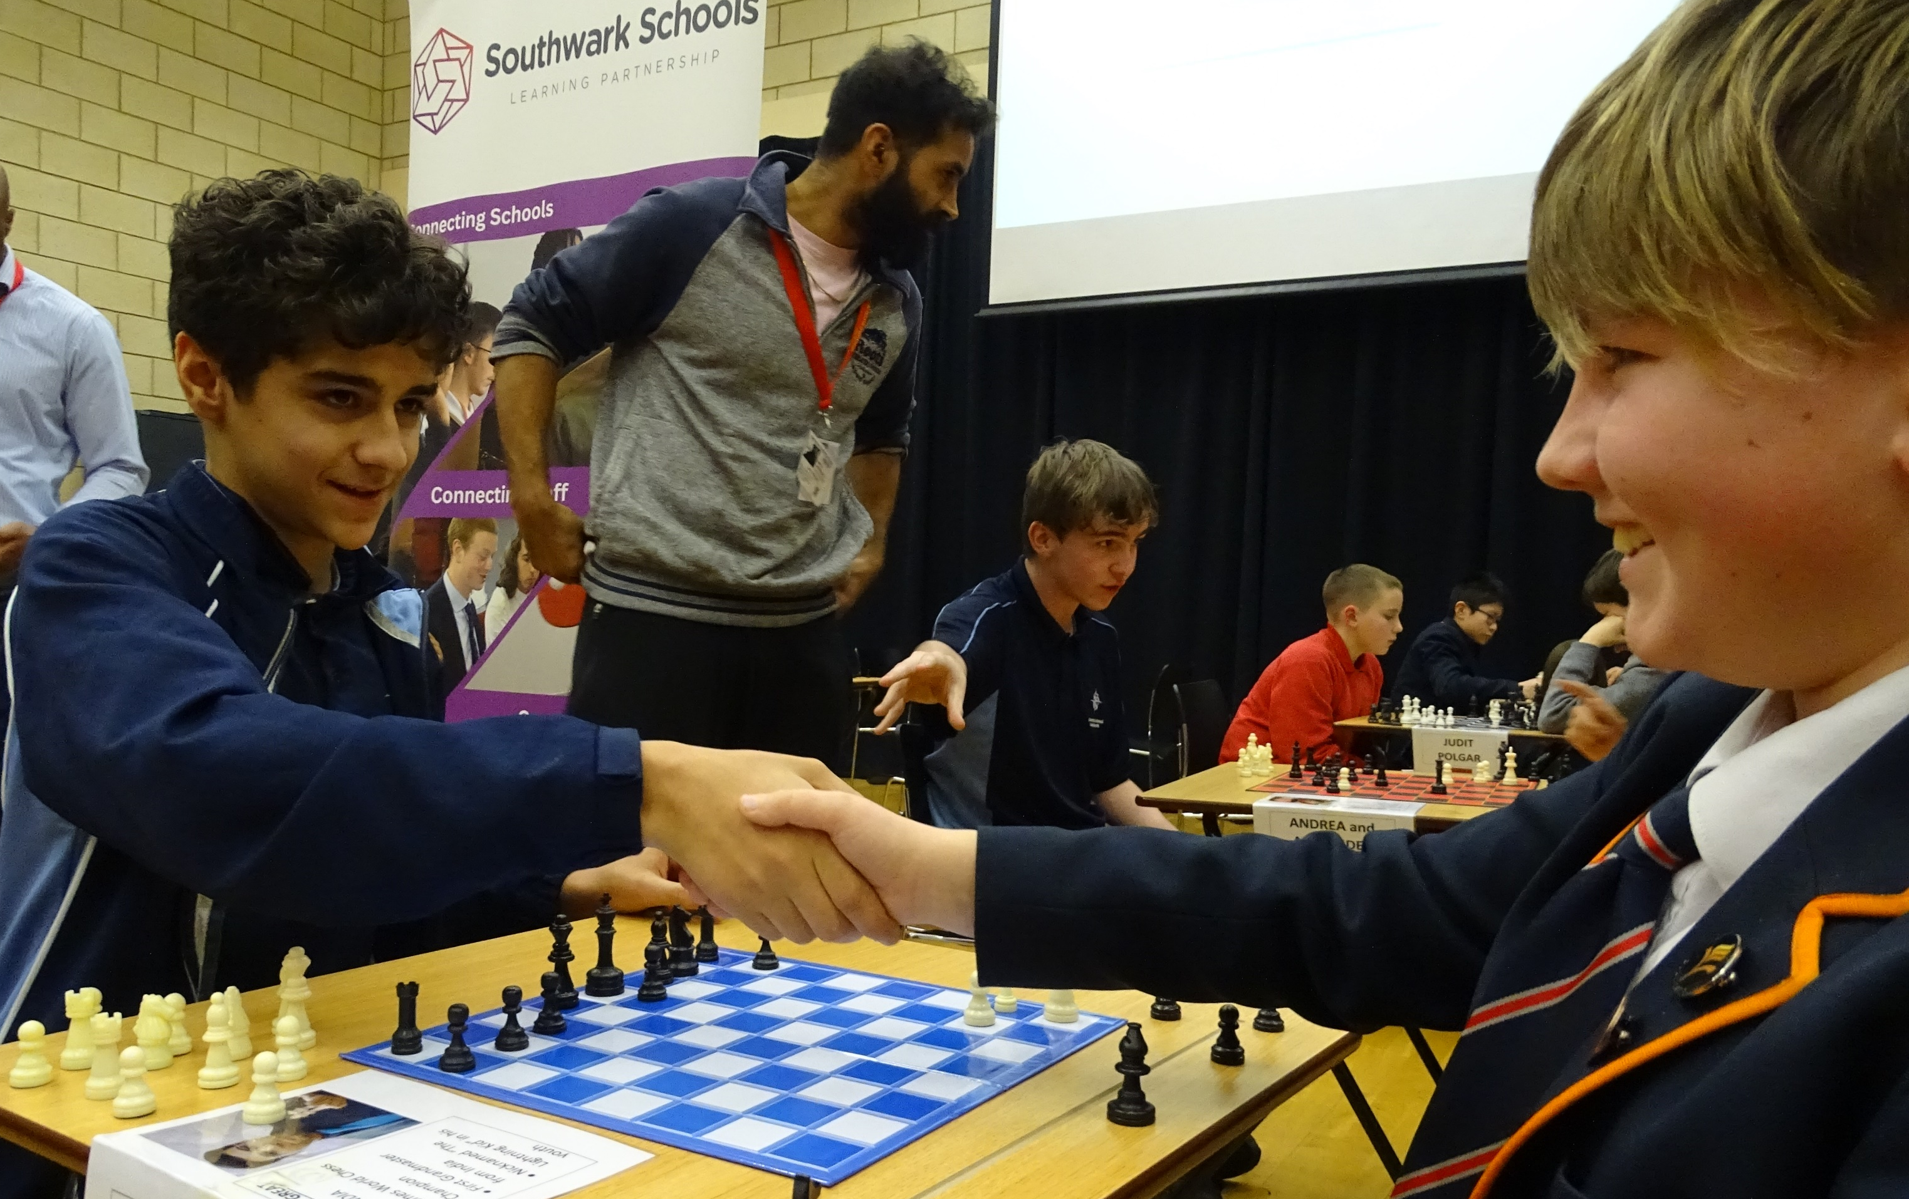
Marcus Huntley
SSLP Co-Director & Principal Charter Bermondsey
“What’s important is that we are all connected and helping each other”
- Anonymous, SSLP Impact Review

Slide 5
Simon Tanner
National Director of SEND for E-ACT
With 10 years as an experienced SENDCo and 6 as a MAT leader for SEND, Simon has developed effective SEND practice across multiple MATs and lead on SEND and MAT SEND reviews across the country.
Simon Co-chairs the MAT SEND Leaders group which he established with Dr Nicola Crossly (Liberty Trust). The group currently have over 100 MAT leaders of SEND and collaborate with Whole Education. Simon is a mentor on Whole Educations MAT SEND leaders programme which last year supported over 250 academies across England and is now moving into its next cohort.
Simon regularly presents at National conferences and was part of EDUKEYs Provision map series in 2020-2021 and TEXTHELPs festivals of education between 2021-2023.

Slide 6
National SEND Landscape
What does the future hold and the importance of collaboration
Simon Tanner
National Director of SEND

Slide 8
Key highlights
Over 1.5 million pupils in England have special educational needs (SEN)
EHCP
The percentage of pupils has increased to 4.3%, from 4.0% in 2022.
The most common type of need is autistic spectrum disorder
The number of pupils has increased by 9% between 2022 and 2023 and by a total of 64% since 2016.
Pupils with an EHC plan made up one quarter (25%) of all pupils with SEN in January 2022.
SEN Support
The percentage of pupils has increased to 13.0%, from 12.6% in 2022.
Speech, language and communication needs is the highest area of need
The number of pupils has increased by 5% from 2022 to 2023 and by a total of 19% since 2016.

Slide 9
Continued…..
In primary, 2.5% of pupils have an EHC plan and 13.5% have SEN support
In secondary, 2.4% of pupils have an EHC plan and 12.4% have SEN support
In state-funded AP schools, 25.5% have an EHC plan and 57.0% have SEN support
In independent schools, including independent special schools, 4.9% of pupils have an EHC plan and 15.2% have SEN support
The largest increase in EHC plans was in primary, with an additional 12,000 pupils with plans since 2022.
The number of pupils with an EHC plan in state-funded AP schools has increased, however the percentage of pupils with an EHC plan has decreased from 28.2% to 25.5%. This is driven by larger increases in the number of pupils in state-funded AP schools with SEN support or no SEN.
The percentage of all pupils with an EHC plan who are in mainstream schools (state-funded primary and secondary) has increased from 51.4% to 52.7% in 2023. The number of pupils in special schools continues to rise, the percentage of all school pupils with an EHC plan who attend state-funded special schools has dropped from 39.4% to 37.9%. These trends continue patterns seen since 2018.

Slide 10
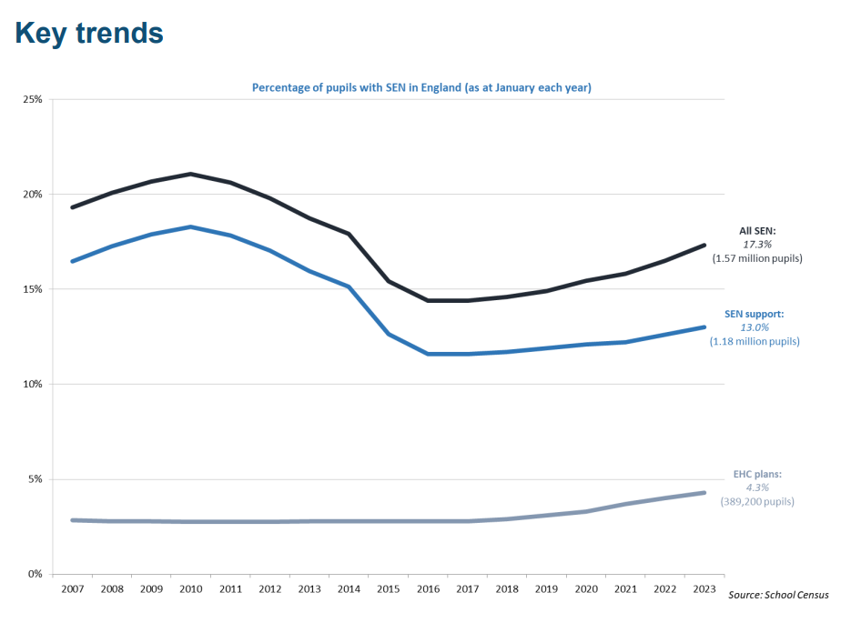

Slide 11
Are we facing hidden cuts?
- 20% cuts to the number of new education plans for children with SEND
- LAs are grappling with huge financial deficits on SEND budgets
- Delivering Better value in SEND (DBV) programme which will support 55 councils to reduce large SEND budgets via earlier intervention & high-quality teaching for children within mainstream
- The DfE’s Send and AP improvement plan really is about significantly reducing EHCPs. But the law is intact, and I urge families to fight any effort to reduce statutory provision at the Send tribunal

Slide 13
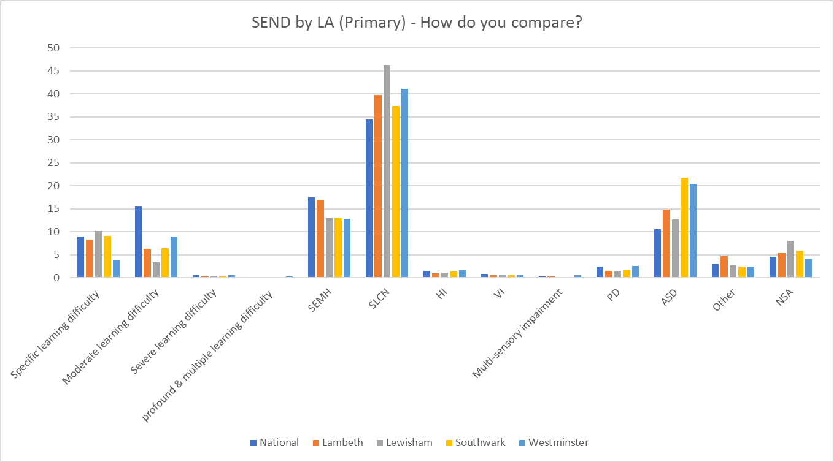

Slide 14
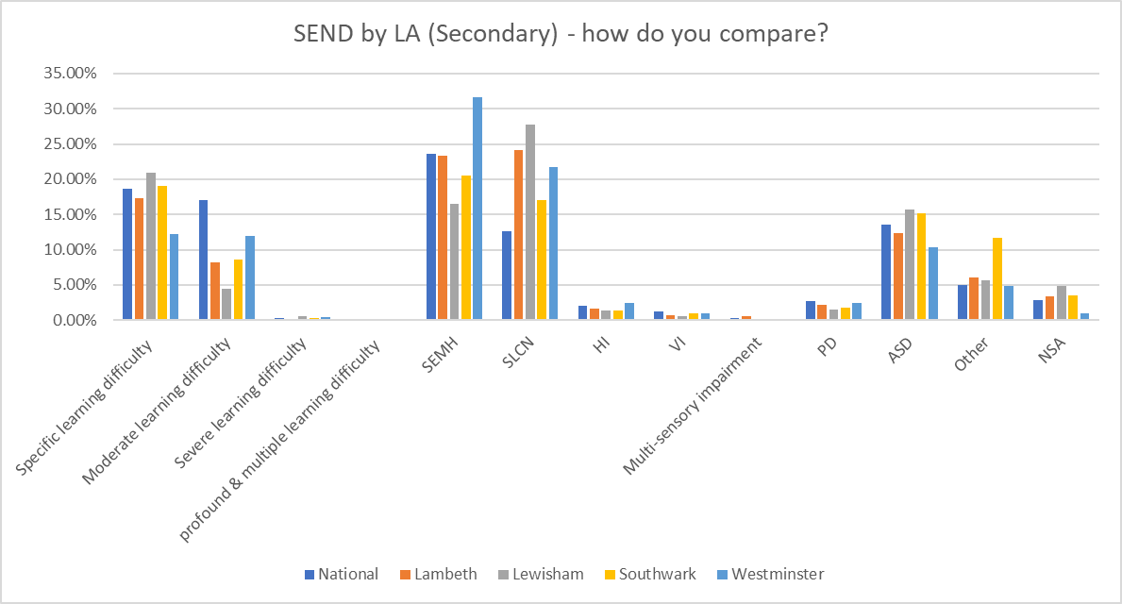

Slide 15
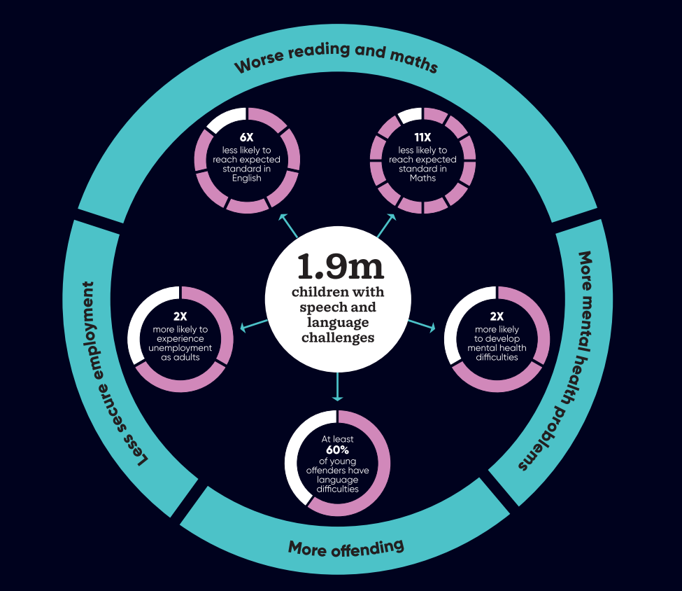

Slide 16
SEND & AP Improvement plan
So, what’s next?
- NPQ SEND
- National Standards
- Consistant approach to funding (Winners and losers)
- Digitised approach to statutory paperwork
- Improvement in SEN Support
- Local area dashboards
- Drive for mainstream

Slide 17
Useful links
Speech and language report – listening-to-unheard-children-report-final.pdf (speechandlanguage.org.uk)
NPQ SEND - National professional qualification for special educational needs co-ordinators (publishing.service.gov.uk)
Hide and Seek report - Hide-and-Seek-report_PDF.pdf (driveryouthtrust.com)
National SEND Data - Special educational needs in England, Academic year 2022/23 – Explore education statistics – GOV.UK (explore-education-statistics.service.gov.uk)
Covert deal to cut help for pupils in England with Special needs - Revealed: covert deal to cut help for pupils in England with special needs | UK news | The Guardian

Slide 19
Anne Sheppee
Neurodiversity Consultant and Dyslexia Specialist
Anne has worked in education for over 25 years as a SENDCo, LEA advisor and now as a Neurodiversity Consultant and Dyslexia Specialist.
She currently works with several schools in South-East London delivering staff training and parent talks as well as carrying out Access Arrangements and full diagnostic dyslexia assessments.
In the last year she has been a speaker at both the TES SEN show in London and the Dyslexia Show in Birmingham. She is particularly passionate about supporting neurodiverse students in the classroom through Quality First Teaching.

Slide 20
Understanding neurodiversity
By
Anne Sheppee
annesheppee@gmail.com
Notes:
A little bit about me:
Live in South London.
Been a Dyslexia specialist for over 15 years - during that time SENDCo in 2 large schools covering 4-18 and an LEA advisor for SpLD. Now working as a consultant developing training programmes for schools and with my dyslexia hat on carrying out full diagnostic assessments.
Also, a mother of 2 children (12 and 15) - one is Dyslexia and other has a range of complex needs
Come here with both hats on!!!!

Slide 21
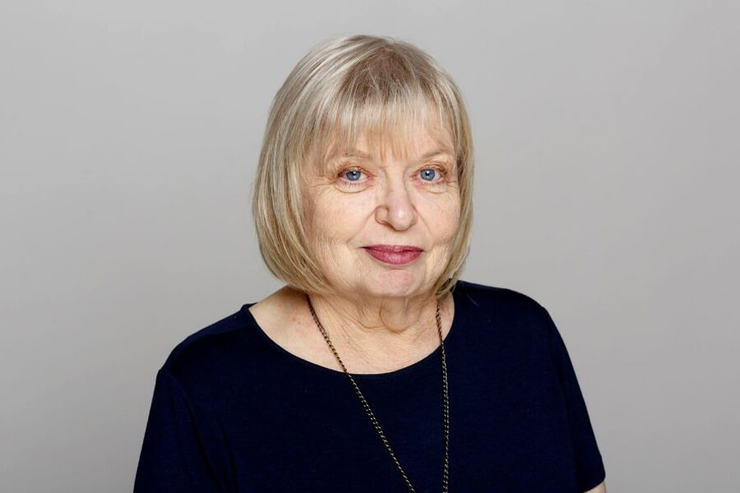
Where does the term Neurodiversity come from?
Judy Singer
Australian Sociologist
1990’s
Notes:
Term made popular by Austrailian Sociologist Judy Singer in the 1990's - AUTISM ACTIVIST
- originally associated very much with autism as a result people wanted to move away from the medical model that existed and instead embrace that this was in fact an important and valuable part of human diversity
concept behind is that:
PEOPLE'S BRAIN'S DO NOT ALWAYS WORK THE SAME WAY and that recognised conditions such as Dyslexia are a variation of the human brain

Slide 22
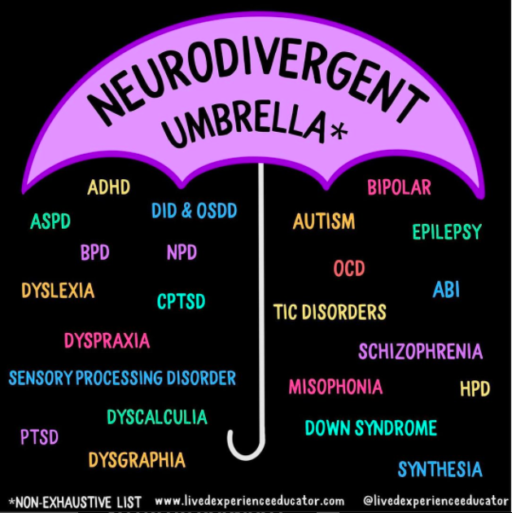
‘Neurodiversity describes the idea that people experience and interact with the world around them in many different ways; there is no one "right" way of thinking, learning, and behaving’
Harvard, 2021
Notes:
positive and accepting
- In recent years, this phrase has been embraced by many other groups who use this term as a means of empowerment. – Dyslexia, Dsycalculia, Dyspraxia (DCD) ,
suddenly we have a viewpoint that brain differences are normal rather than deficits. This aims to reduce the stigma around learning and thinking differences.
From this we coined the terms
neurodivergent
neurotypical

Slide 23
Individuals with different…..
Skills
Abilities
Needs
Notes:
When we start to think about natural differences in the brain, we can begin to view children with a range of different skills abilities and needs - this reframes our way of thinking
Notice that needs comes last!
SEND code of practice talks about the importance of having high expectations for children with SEN
teachers can lower expectations for neurodiverse learners - in order for a child to achieve their potetial it is important that a childs strengths are identified and taken into account as much as their weaknesses!!!!

Slide 24
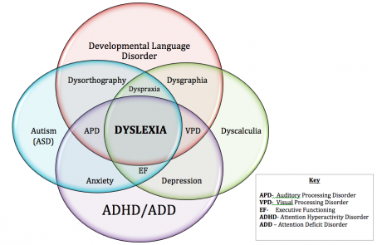
Co-Occuring Difficulties

Slide 25
How does this impact within the classroom
Notes:
TEACHERS ARE NOT TRAINED!
fast paced learning environment - still playing catch up with some children (COVID)
Mixed ability classes - current research favours this with exception of maths
supporting children with complex needs
strengths and challenges
digital classroom - cover
Quality First Teaching
understanding what works for our neurodivergent children works for everyone
non-negotiables

Slide 27
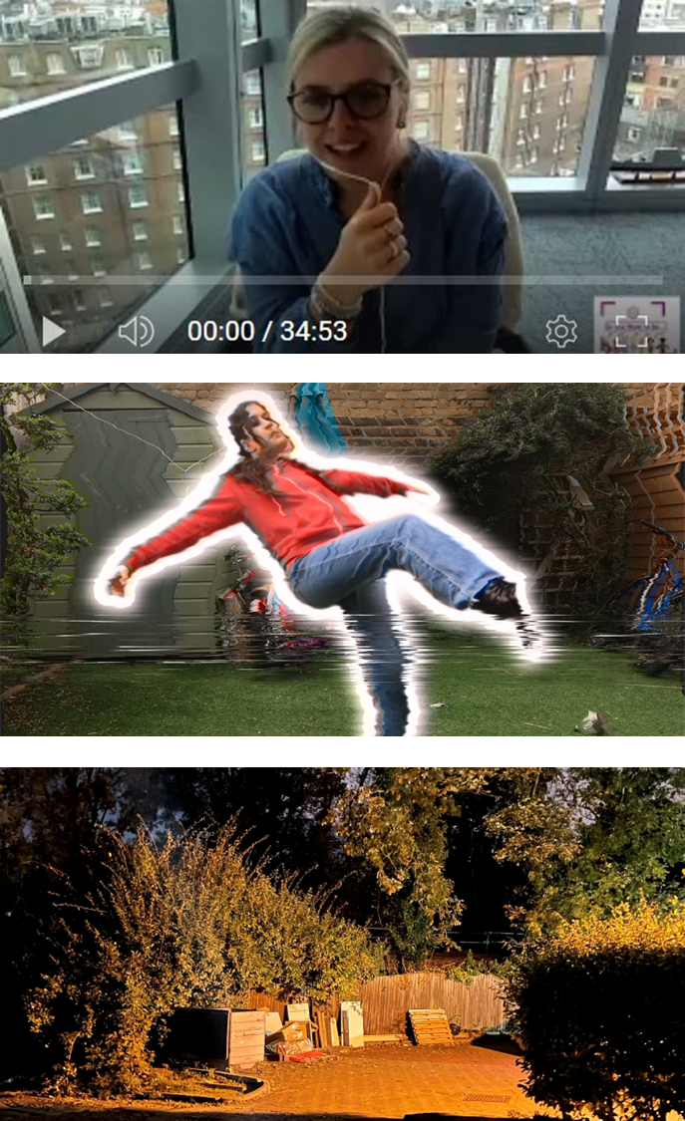
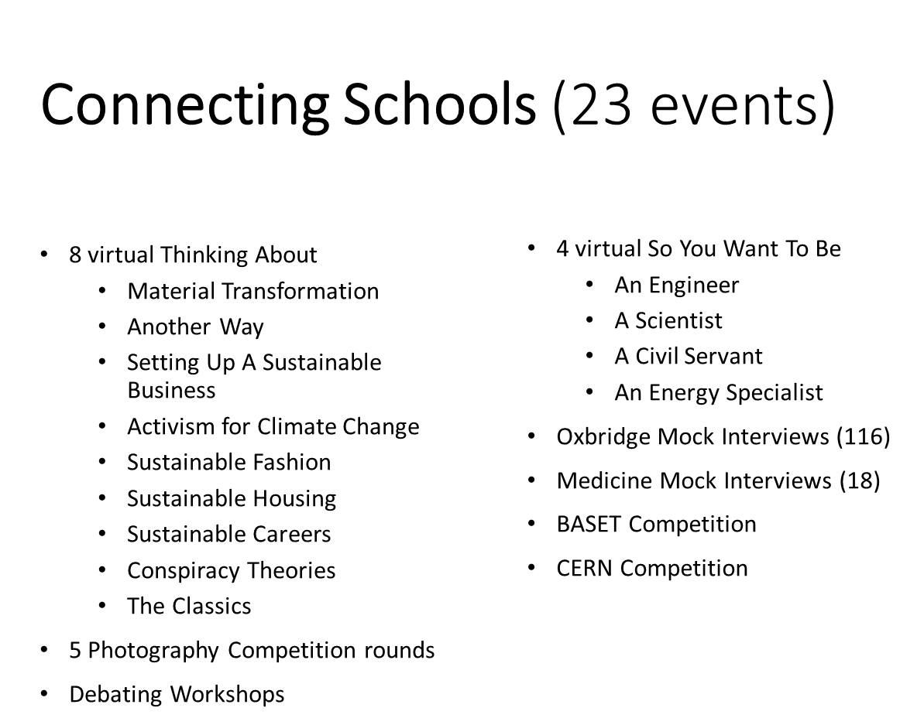
Katie Barretta
SSLP Coordinator

Slide 28
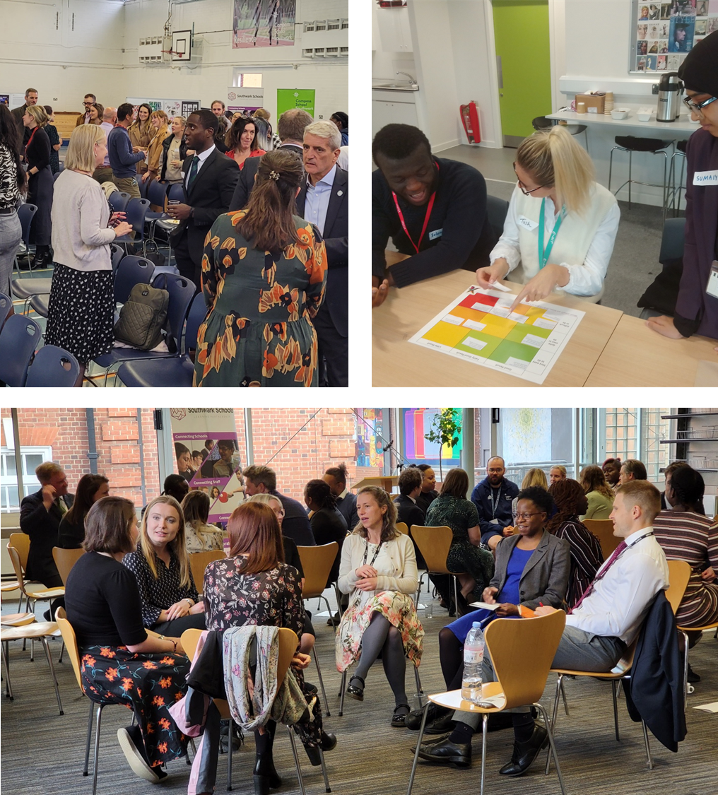
Katie Barretta
SSLP Coordinator
Connecting Staff (13 events)
SSLP Launch
2 Oxbridge Preparation Sessions
Bring About Change Training
Debate Mate Teacher Training
4 Aspiring Pastoral Leaders
Hub meetings
Library
Music
Counsellors
End of Year Dinner

Slide 29
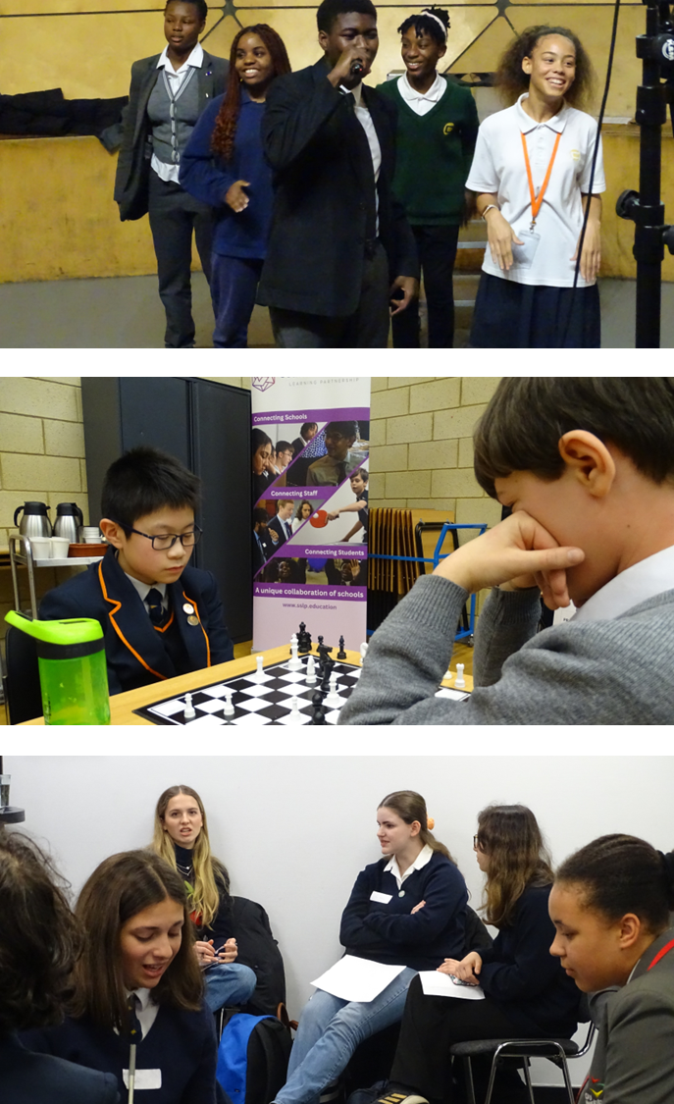
Katie Barretta
SSLP Coordinator
Connecting Students (37 events)
6 Oxbridge Preparation Courses
3 SSLP Student Ambassador Meetings
2 Live Thinking Abouts
Black History with Floella Benjamin
Medicine with Adam Kay
Chaos Symposium
Student Voice Sustainability Conference
10 Sustainability Project Meetings
Sustainable Cookery Classes
Waste Less & Recycle more
Awareness of Food Banks
Re-use events
Student Voice Sustainability Project Launch
Gospel Choir Workshop
Write on Art Workshop
Sixth-form Science Quiz
Table Tennis Competition
Baroque Music Workshop
Song-writing Workshop
Debating Competition
The Future of Chemical Engineering and AI
Stained Glass Tour and Workshop
Woodlands Farm Field Day
Young Economists Conference
CERN Summer Particle Physics School

Slide 30
Connecting Schools
SSLP Events
3rd October – SSLP Apprenticeship Fair
4th October – SSLP Basketball Competition
Oxbridge Preparation Support
SSLP Photography Competition
5th November – So You Want To Be
WCIB Debating workshops
BASET trip to Canberra
Weekly newsletter

Slide 31
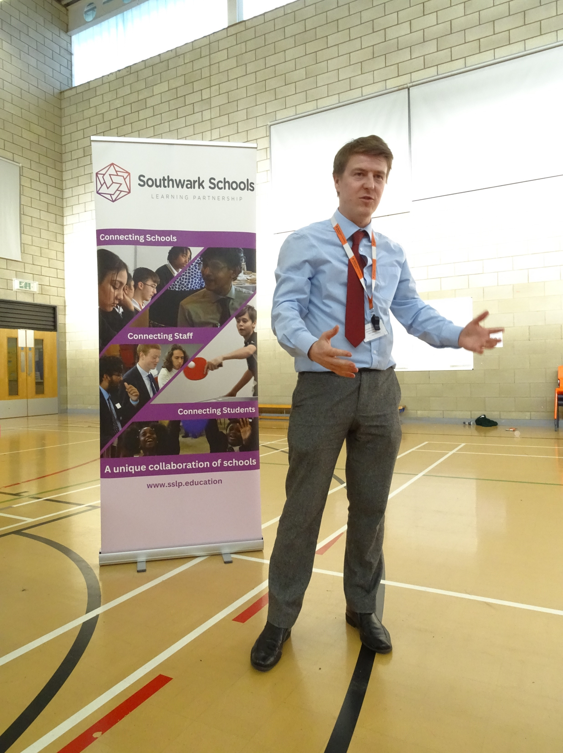
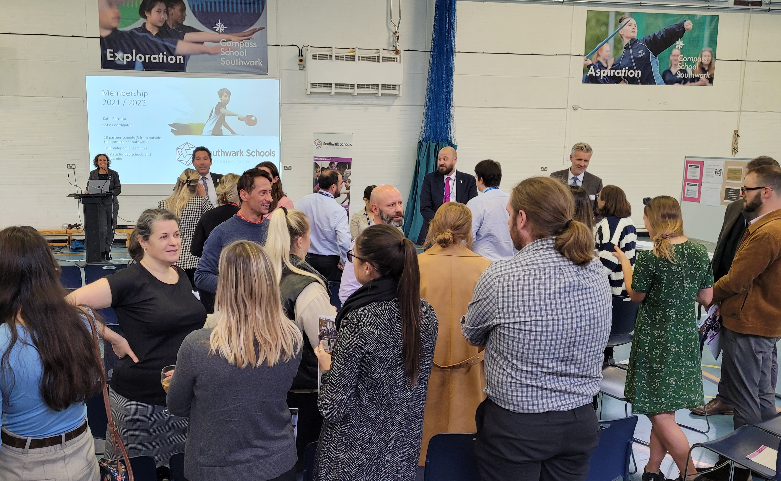
Connecting Staff
SSLP Events
18th September – SSLP Launch
5th October – Library Hub
14th November – Aspiring Leaders
Open Events
13th October – NASBTT Mentor Training
16th October – Exam Officers Training

Slide 32
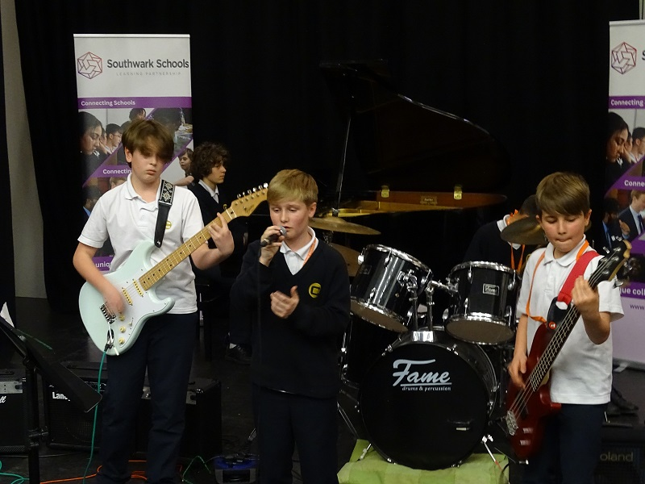
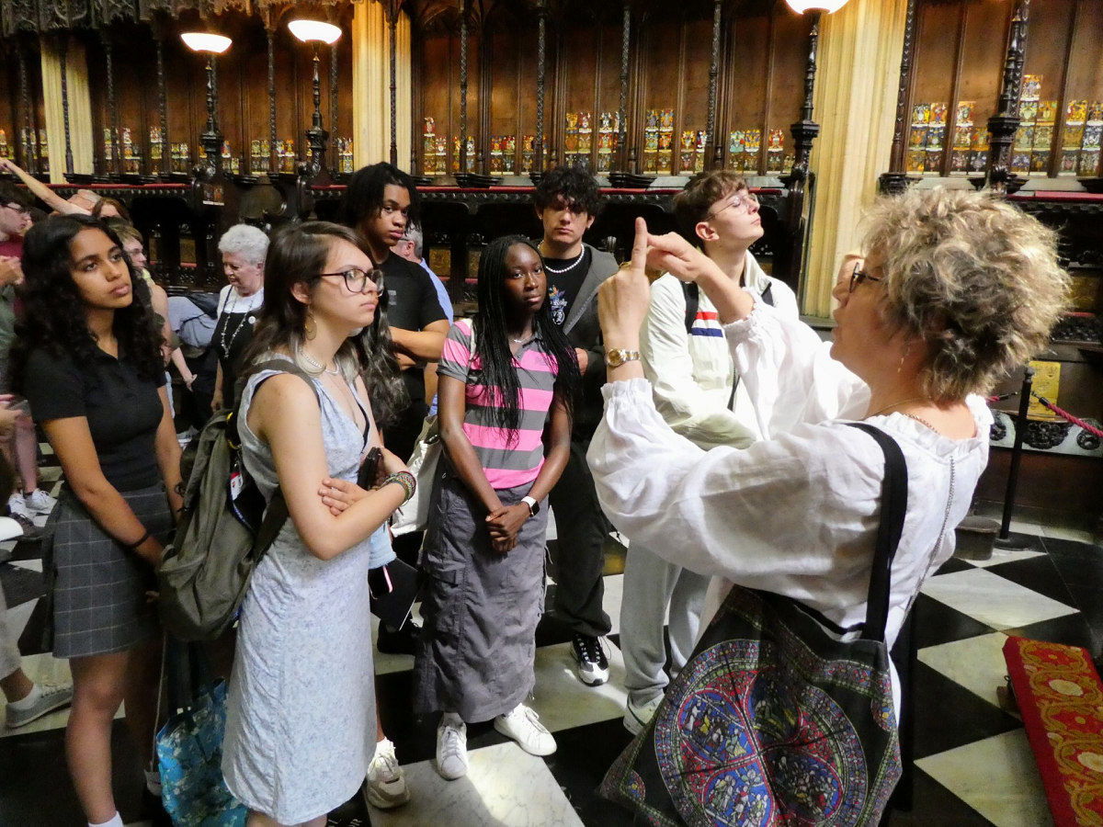
Connecting Students
SSLP Events
22nd September – Photography Workshop
9th October – Leadership training
11th October – Ambassador Meeting
22nd November – Neurodiversity Conf
28th November – Thinking About (Live)
Open Events
Monday evening talks at Alleyn’s
Standing Firm Football’s Windrush Story
Emmanuel Jal – talks

Slide 33
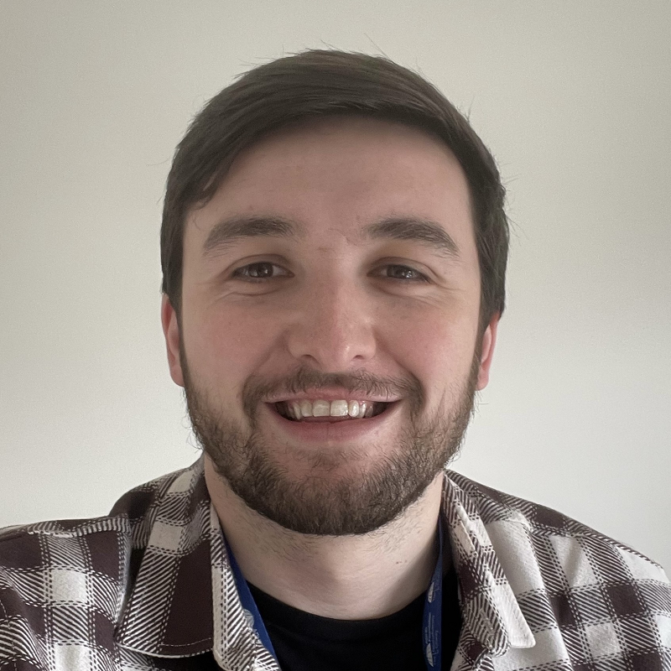
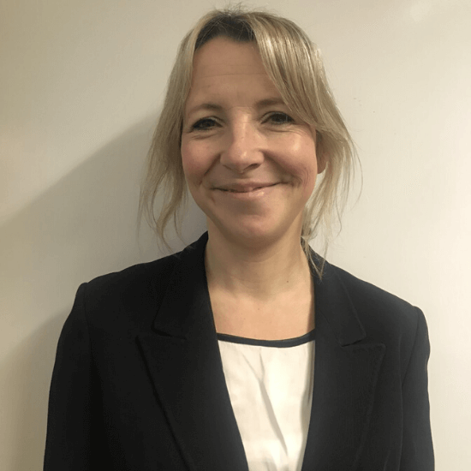
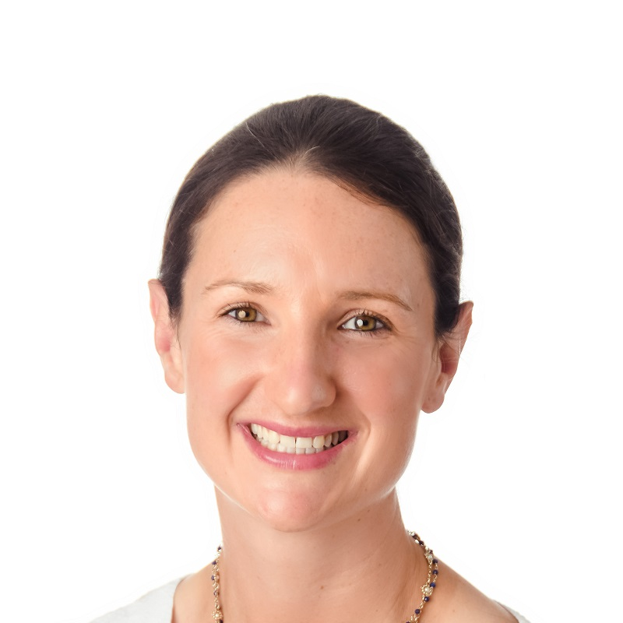
Aspiring Leaders: Neurodiversity
What is it?
Approximately 20% of the population has a neurological difference. During your teaching career you will have in your classes students who learn in a variety of ways. Neurodiversity is now a responsibility for every teacher, just like safeguarding, and also for every manager of people. An understanding of Neurodiversity is important for all stages of your career and will help you to be a better teacher and leader for all those that you work with.
Understanding Neurodiversity 1
Getting a Diagnosis (focus on ADHD)
Tues 14th November 2023, 5pm
Arron Hutchinson
Education Training Director ADHD Foundation – The Neurodiversity Charity.
Understanding Neurodiversity 2
Support and adaptations (focus on Dyslexia) Tues 6th February 2024, 5pm
Dr Grace Elliott
Teacher, Trainer and Assessor British Dyslexia Association
Understanding Neurodiversity 3
Life After School (focus on Autism)
Tues 19th March 2024, 5pm
Danae Leaman-Hill
Director of External Affairs Ambitious About Autism
Networking Dinner
Tues 7th May

